Slide 1
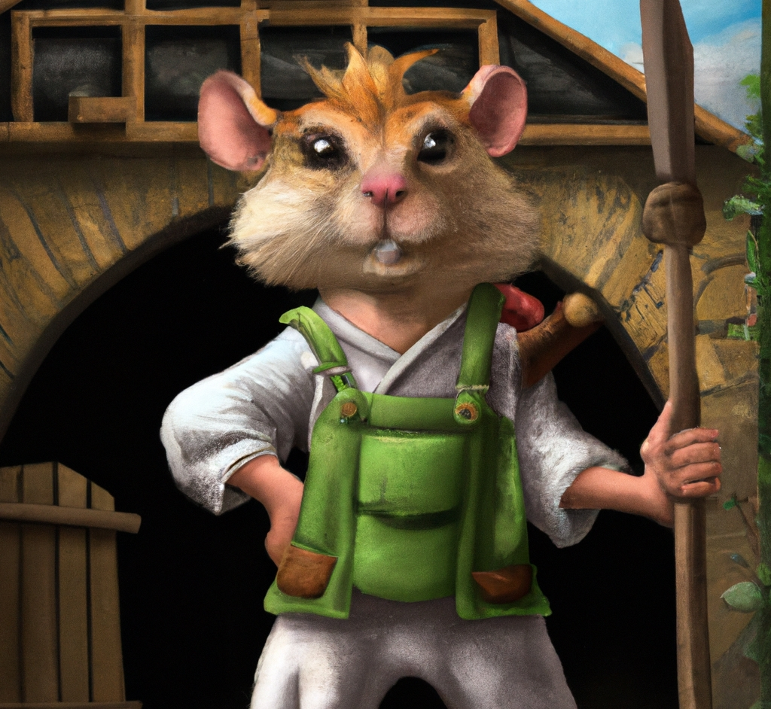
“Anthropomorphic gerbil in overalls holds a spear and stands in front of his farmhouse, digital art”
DALL·E 2

Slide 2
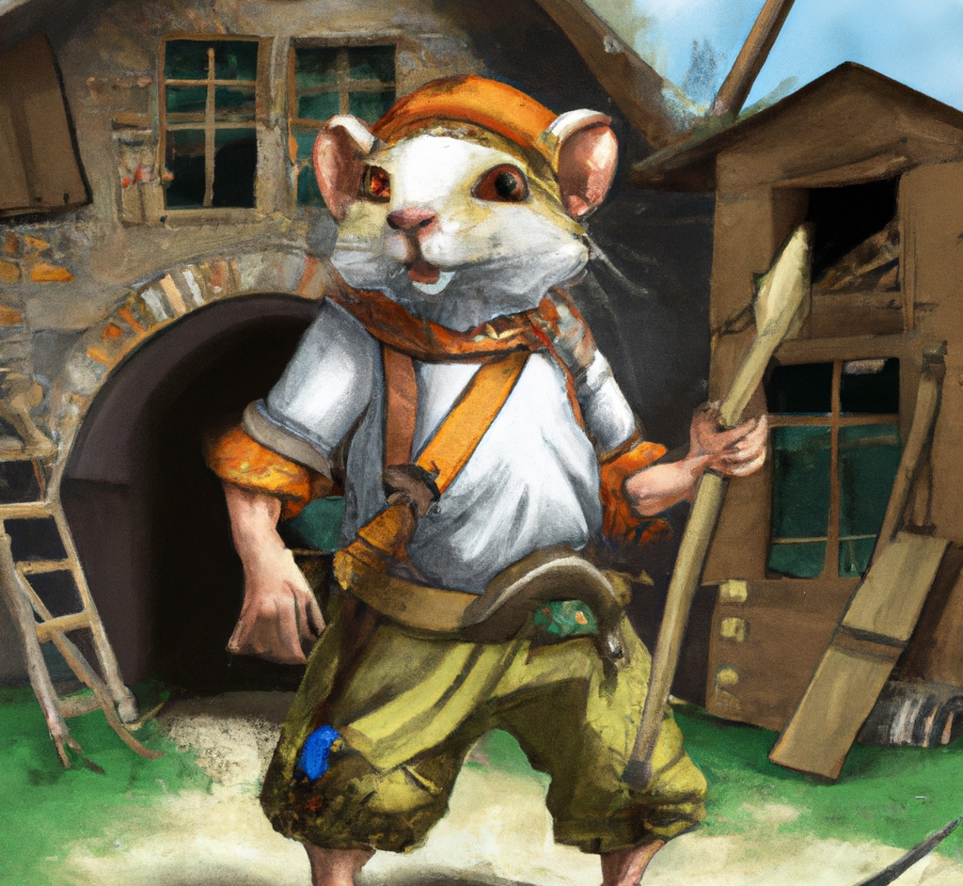
“Anthropomorphic gerbil in overalls holds a spear and stands in front of his farmhouse, digital art”
DALL·E 2

Slide 3
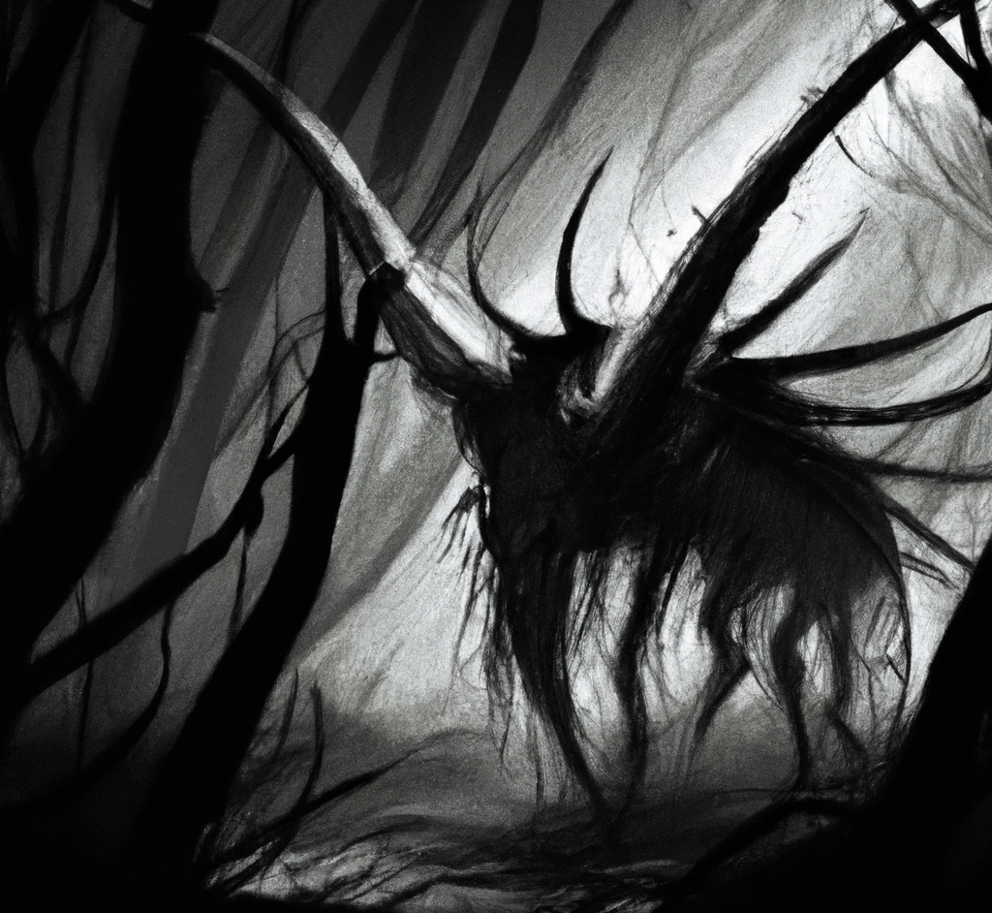
“Shadow creature, digital art”
DALL·E 2

Slide 4

“A Welsh Corgi wearing a beret and black turtleneck”
DALL·E 2

Slide 5
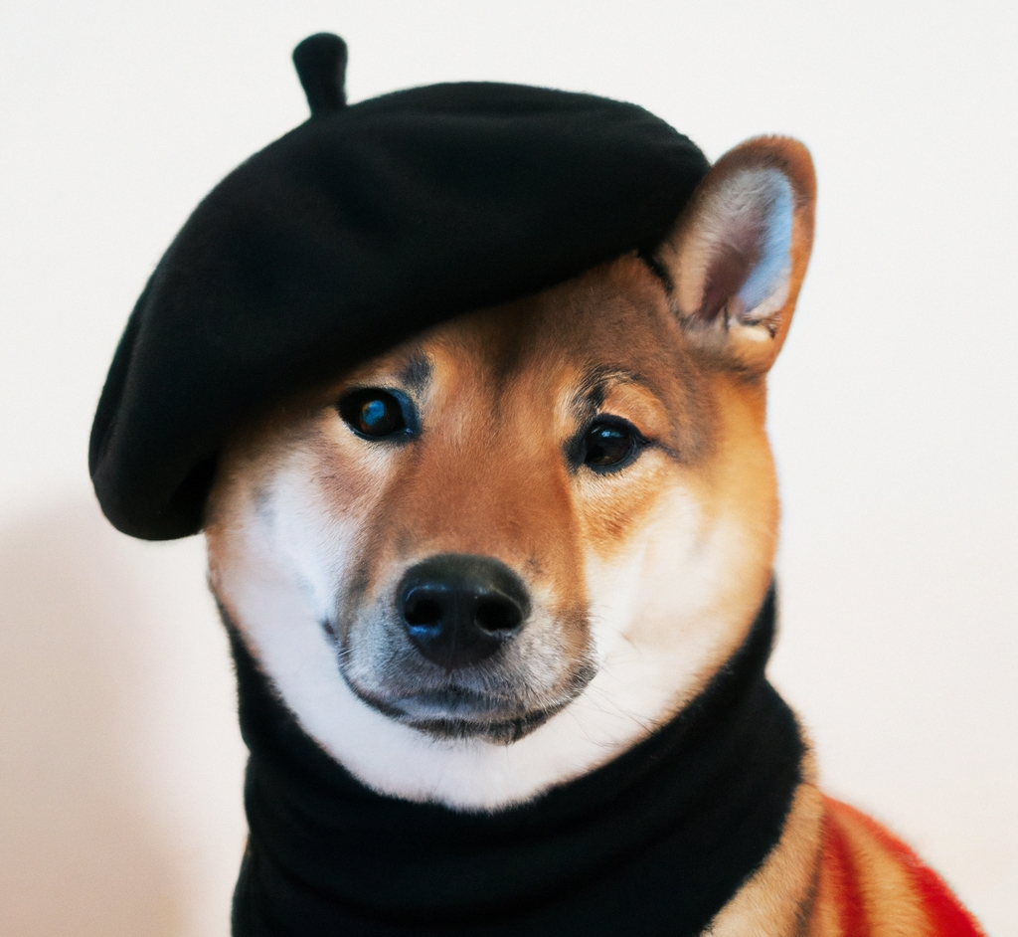
“A Shiba Inu dog wearing a beret and black turtleneck”
DALL·E 2

Slide 6
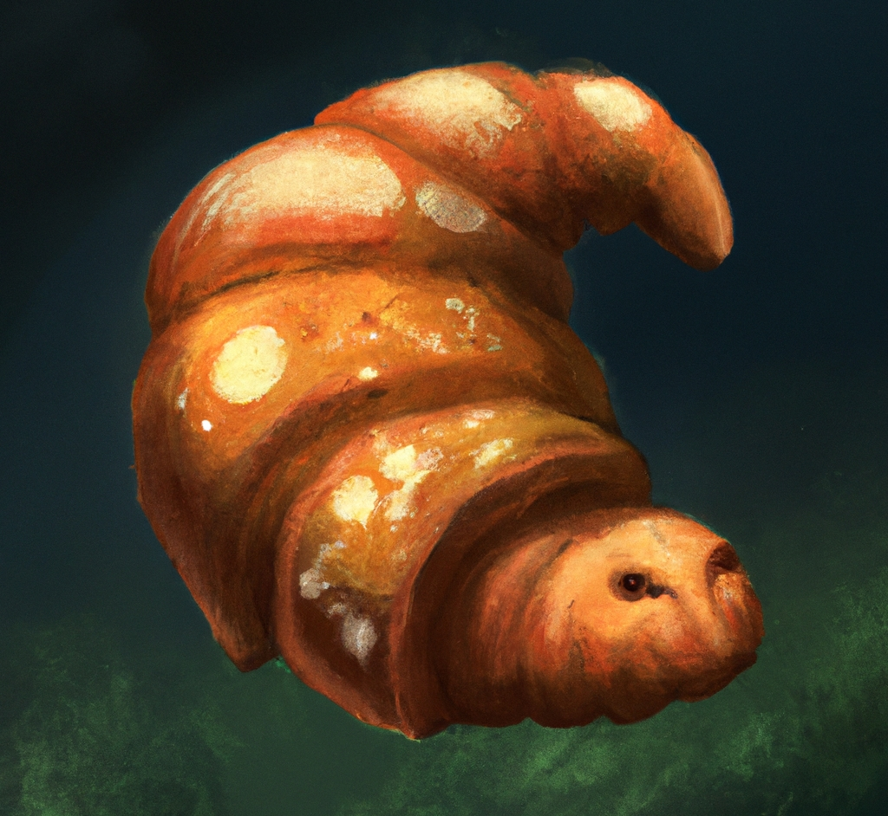
“Tardigrade croissant, digital art”
DALL·E 2

Slide 7
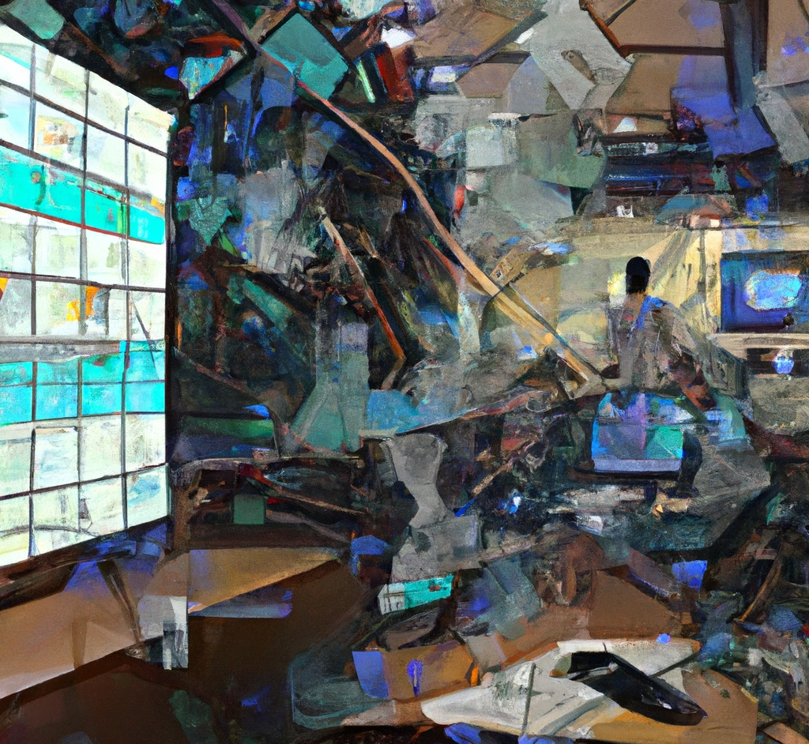
“An impressionist painting of a workplace with a futuristic augmented reality interface covering every surface”
DALL·E 2

Slide 8
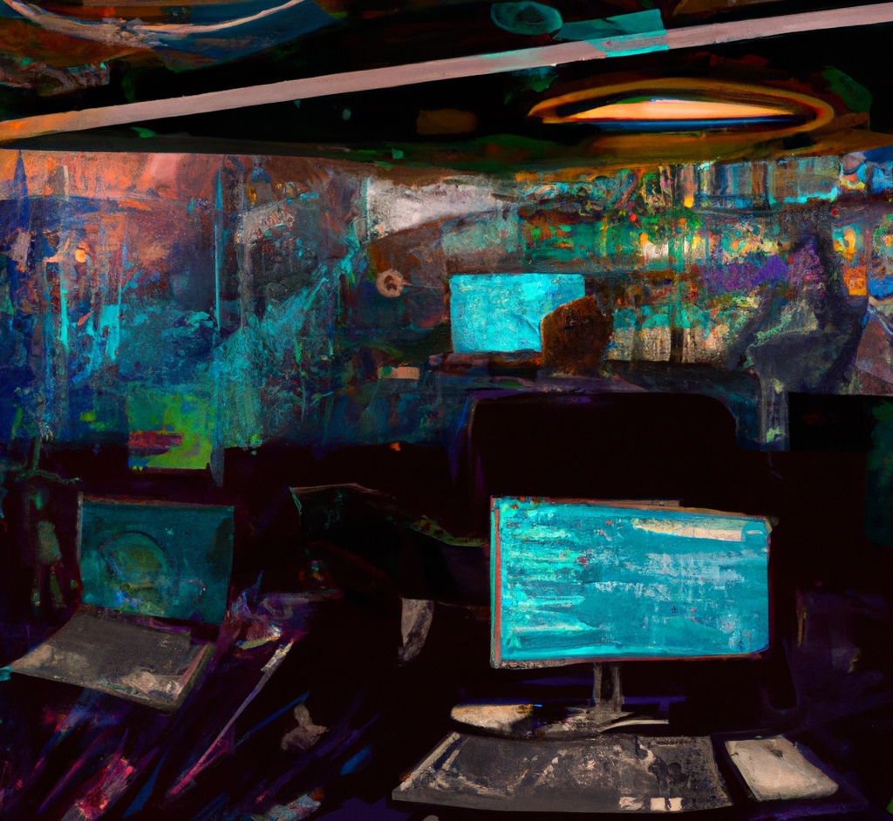
“An impressionist painting of a workplace with a futuristic augmented reality interface covering every surface”
DALL·E 2

Slide 9
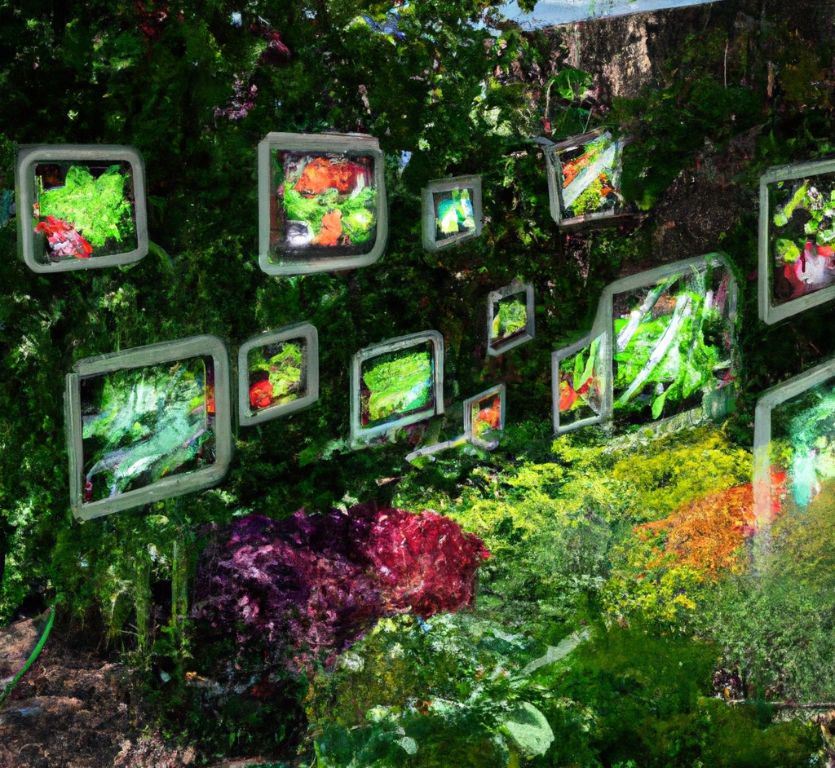
“A garden with a variety of vegetables. The plants are decorated with minority report style augmented reality holograms.”
DALL·E 2

Slide 10
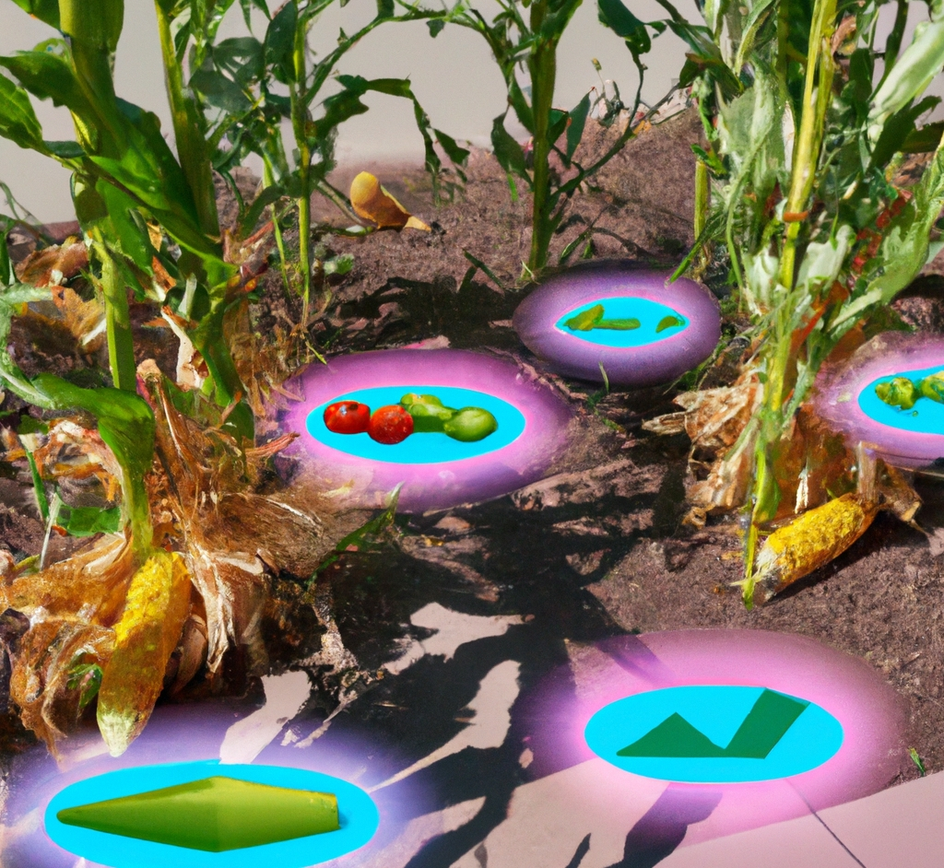
“A garden with corn and tomatoes. The plants are decorated with augmented reality holograms showing soil moisture and mineral levels.”
DALL·E 2

Slide 11
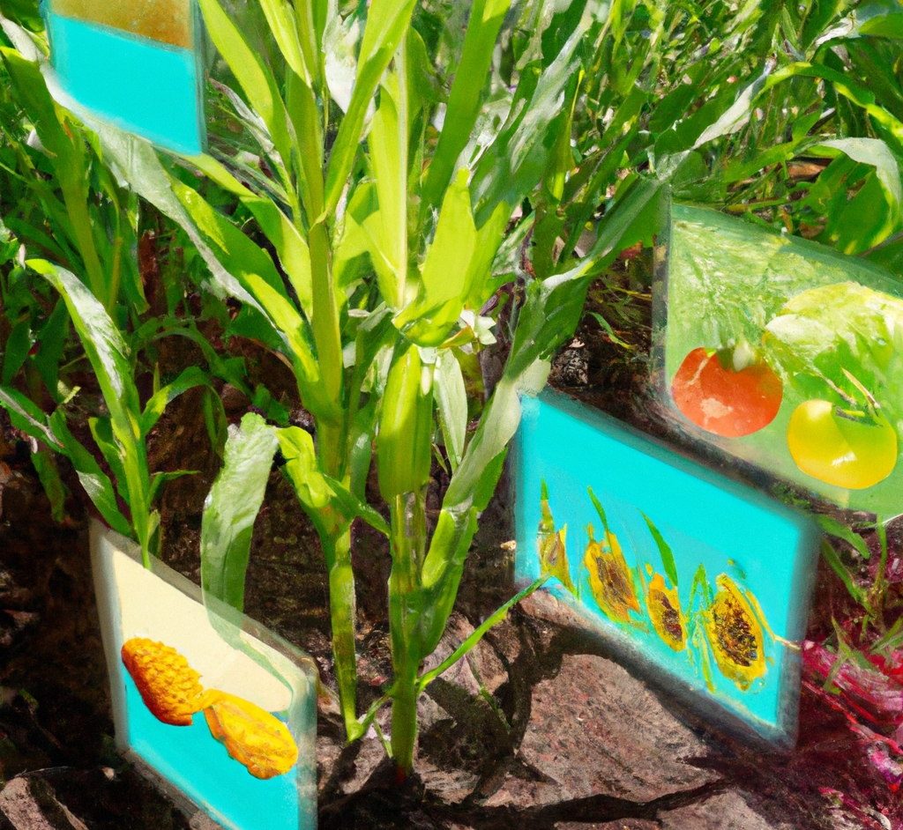
“A garden with corn and tomatoes. The plants are decorated with augmented reality holograms showing soil moisture and mineral levels.”
DALL·E 2

Slide 12
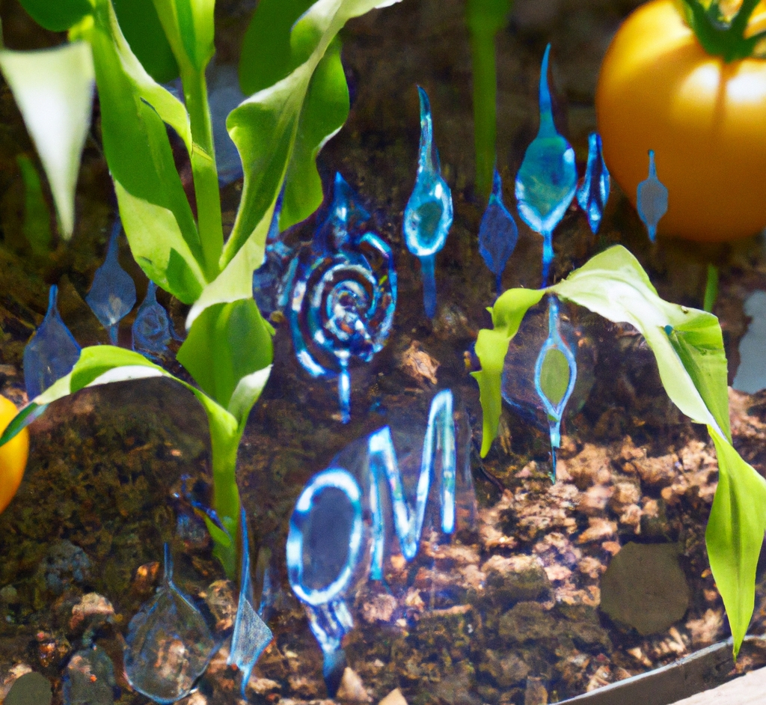
“A close up photo of a garden with corn and tomatoes. The plants are decorated with futuristic Iron Man style holograms showing soil moisture and mineral levels.”
DALL·E 2

Slide 13
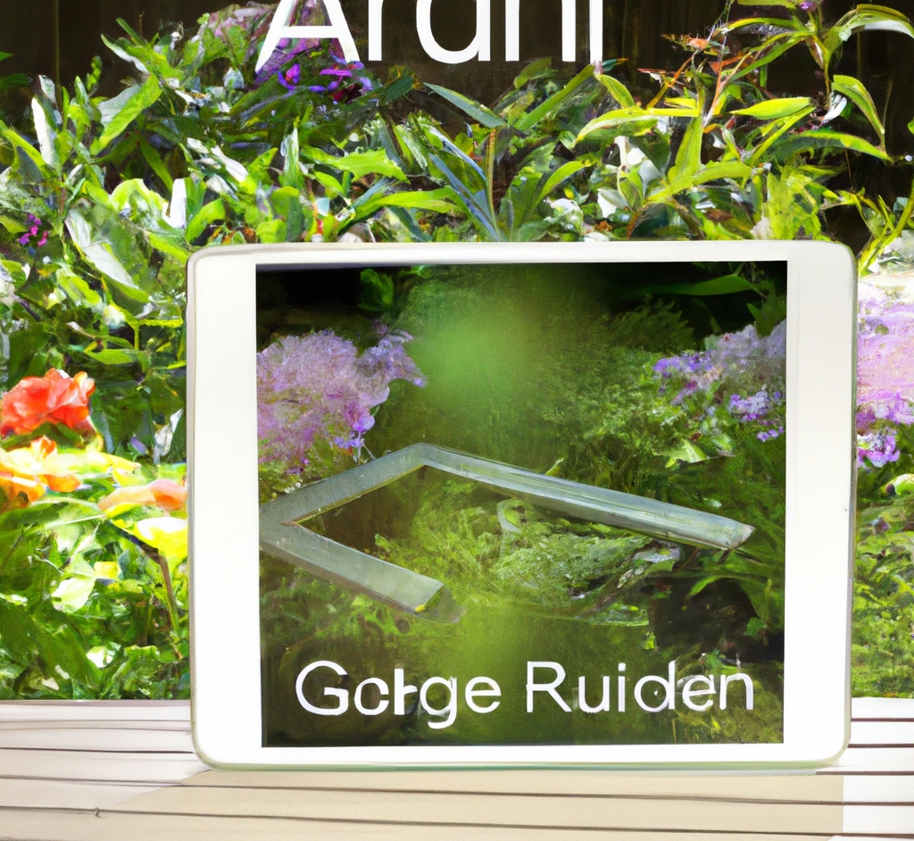
“augmented reality garden app for your ipad”
DALL·E 2

Slide 14
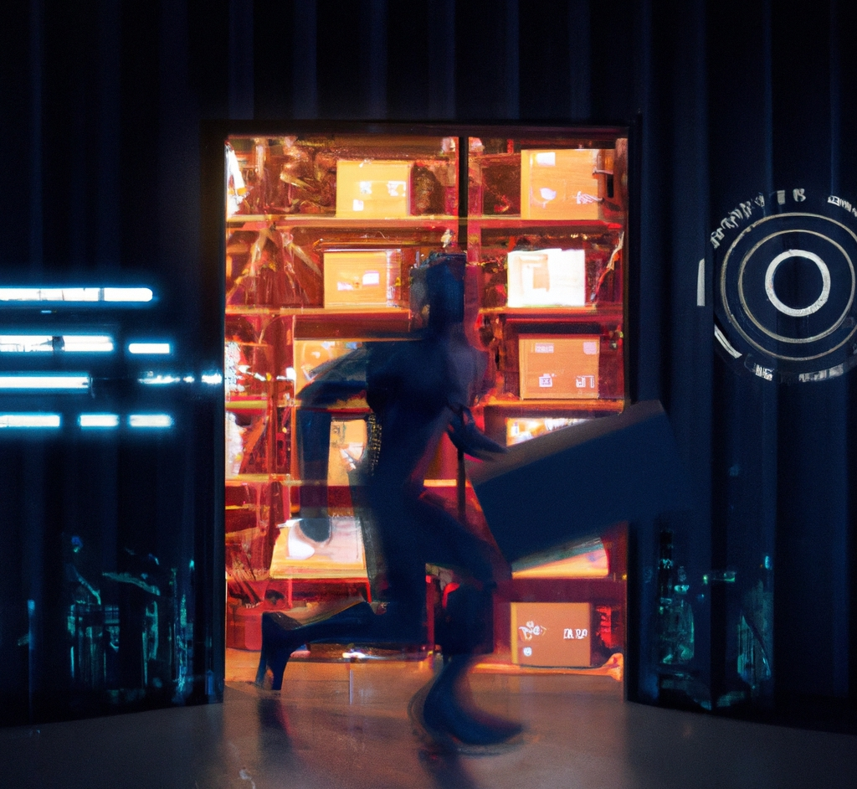
“A warehouse with futuristic Iron Man style shipment data holograms”
DALL·E 2

Slide 15
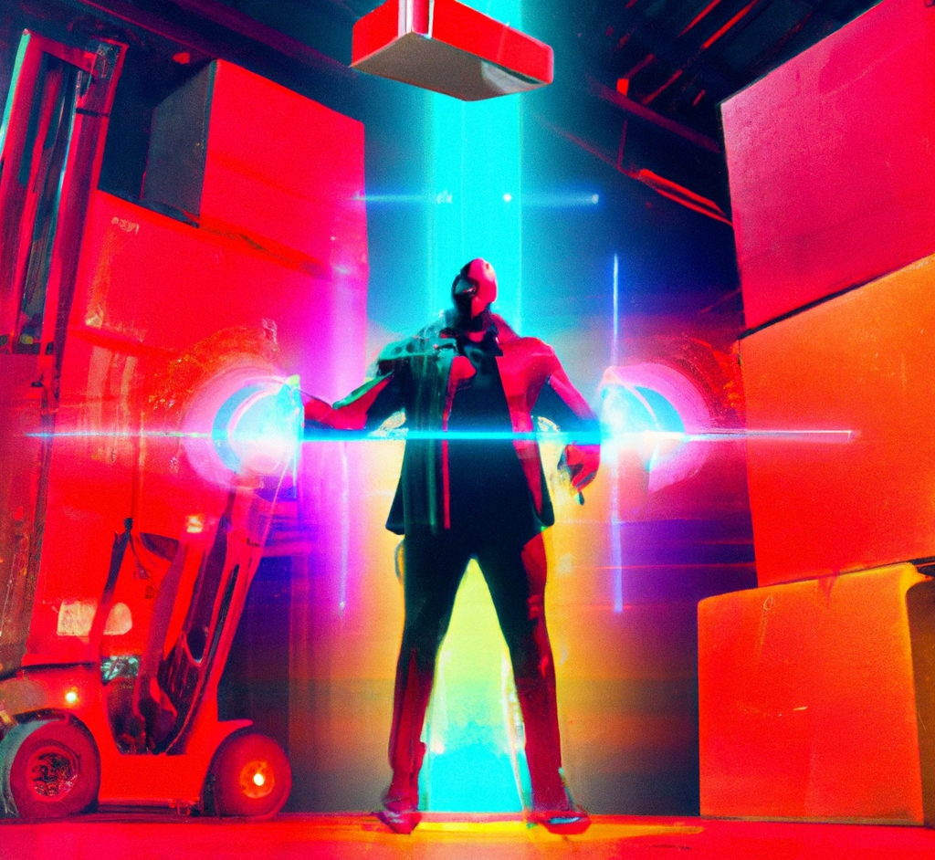
“A warehouse with futuristic Iron Man style shipment data holograms”
DALL·E 2

Slide 16
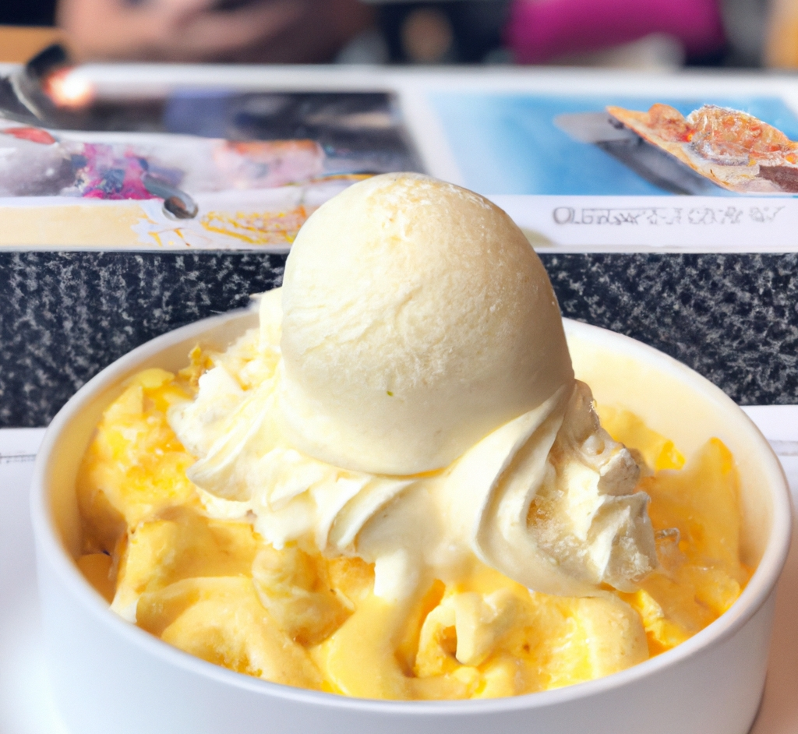
“macaroni and cheese ice cream”
DALL·E 2

Slide 17
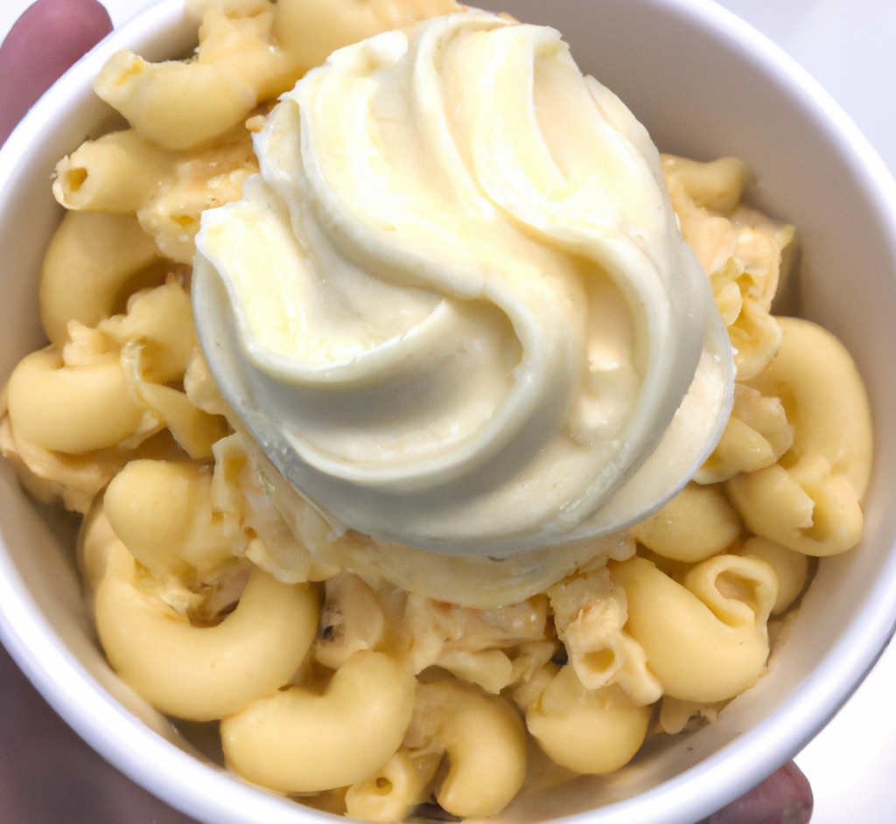
“macaroni and cheese ice cream”
DALL·E 2

Slide 18
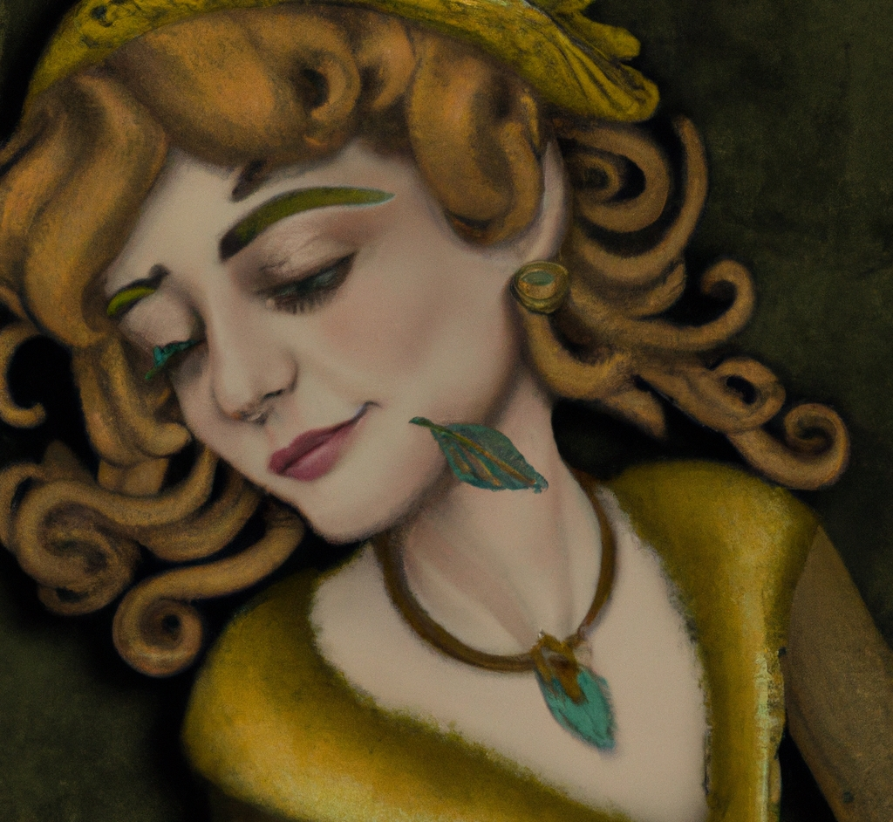
“dall-e self portrait, by dall-e”
DALL·E 2

Slide 19
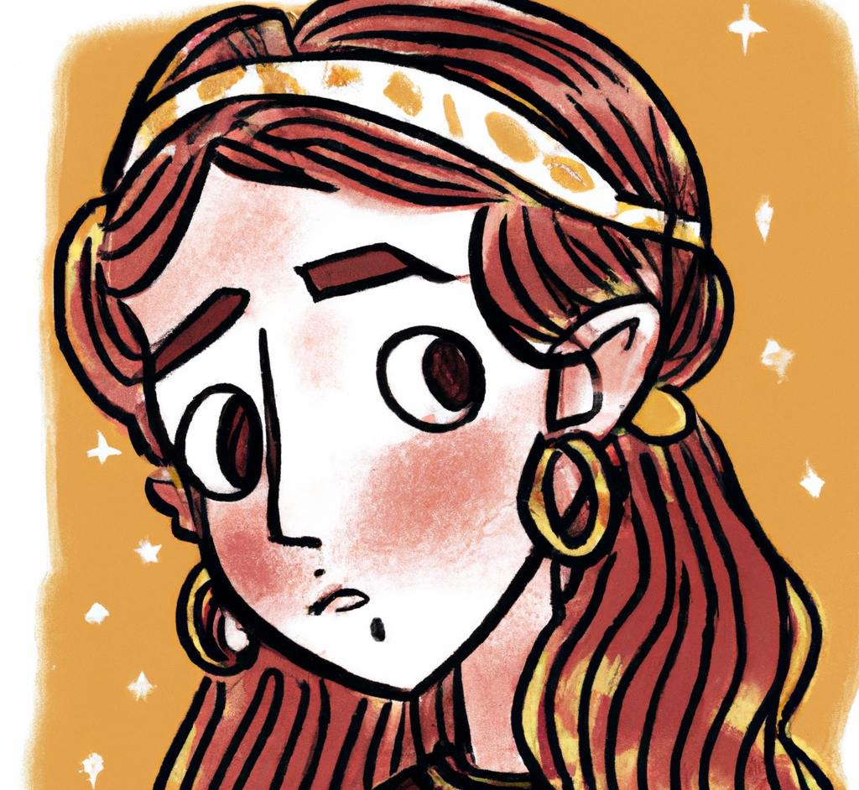
“dall-e self portrait, by dall-e”
DALL·E 2

Slide 20
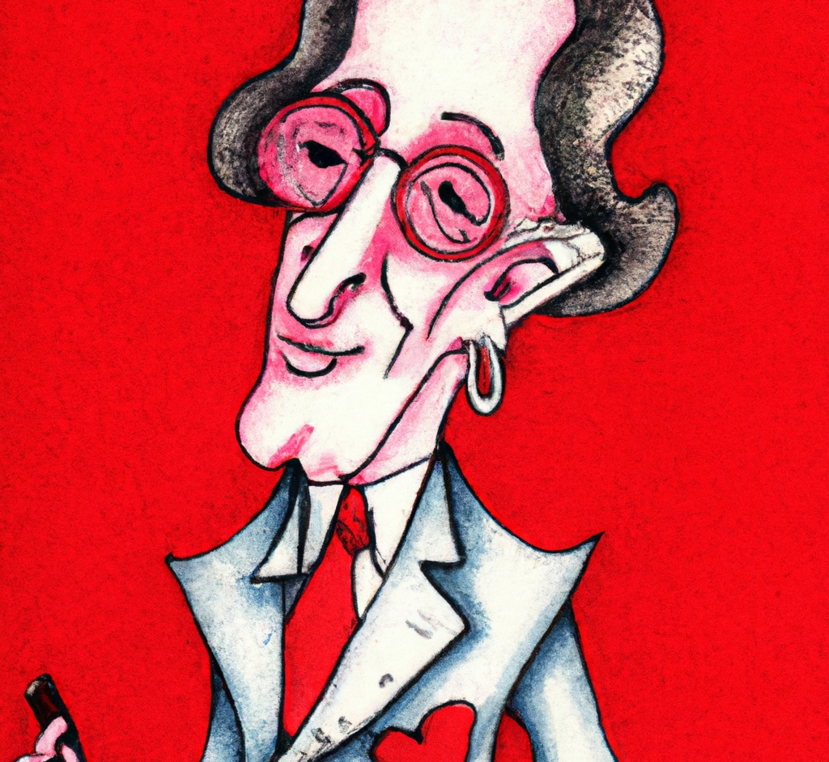
“dall-e self portrait, by dall-e”
DALL·E 2

Slide 21
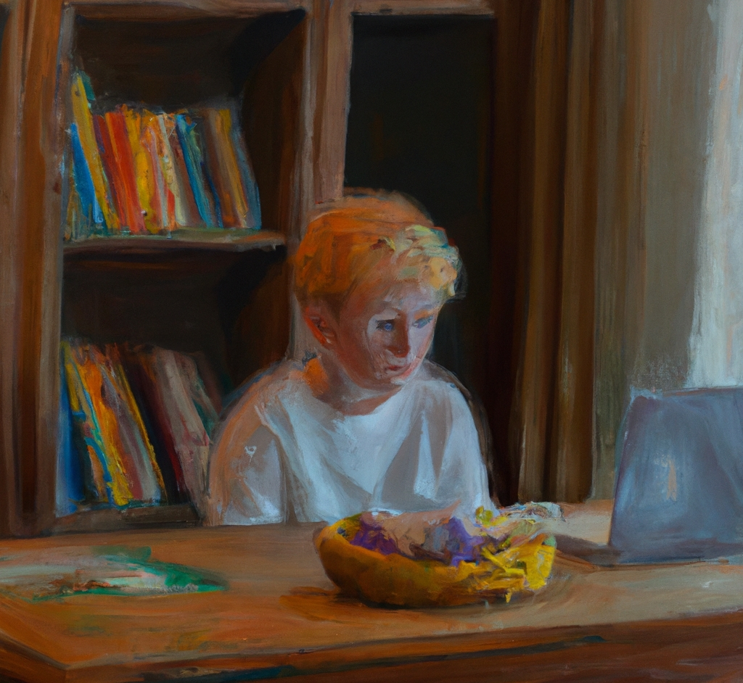
“A boy with blond hair sits on a wooden dining room table. There is a laptop and some fruit on the table. Oil painting.”
DALL·E 2

Slide 22
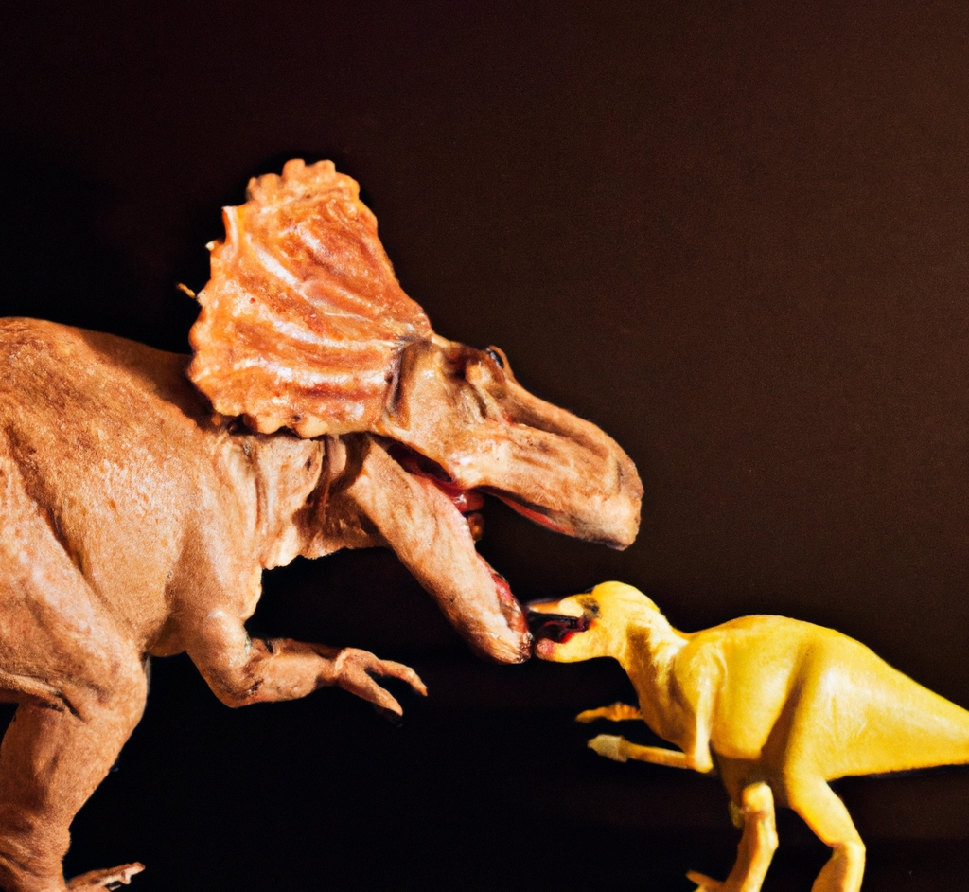
“A dinosaur eating a dinosaur”
DALL·E 2

Slide 23
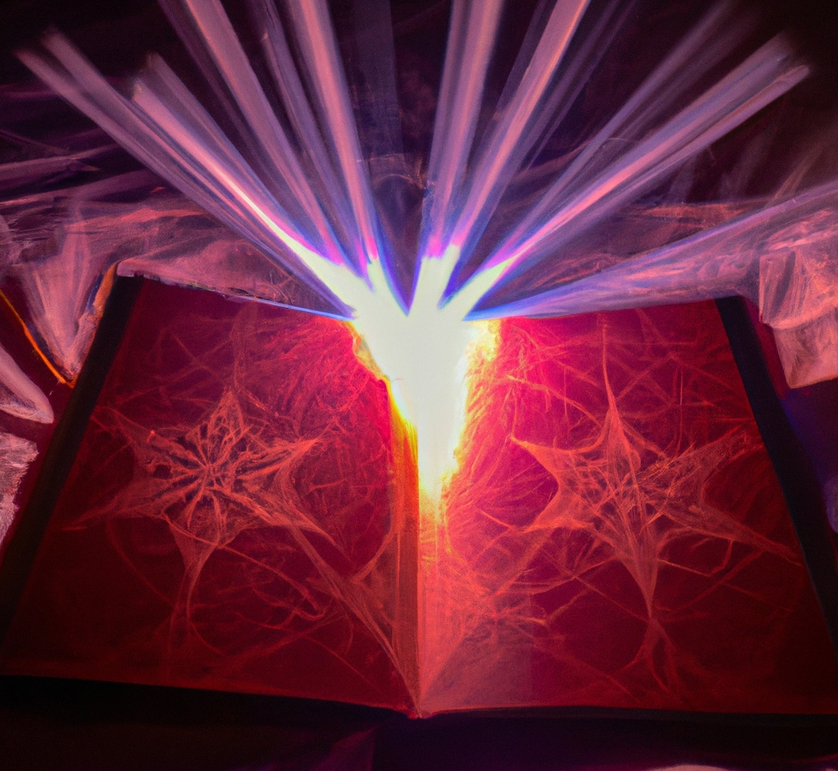
“A book with dark magic that makes things real”
DALL·E 2

Slide 24

“An octopus with wings, flying in the sunshine, and the octopus has eaten the moon.”
DALL·E 2

Slide 25
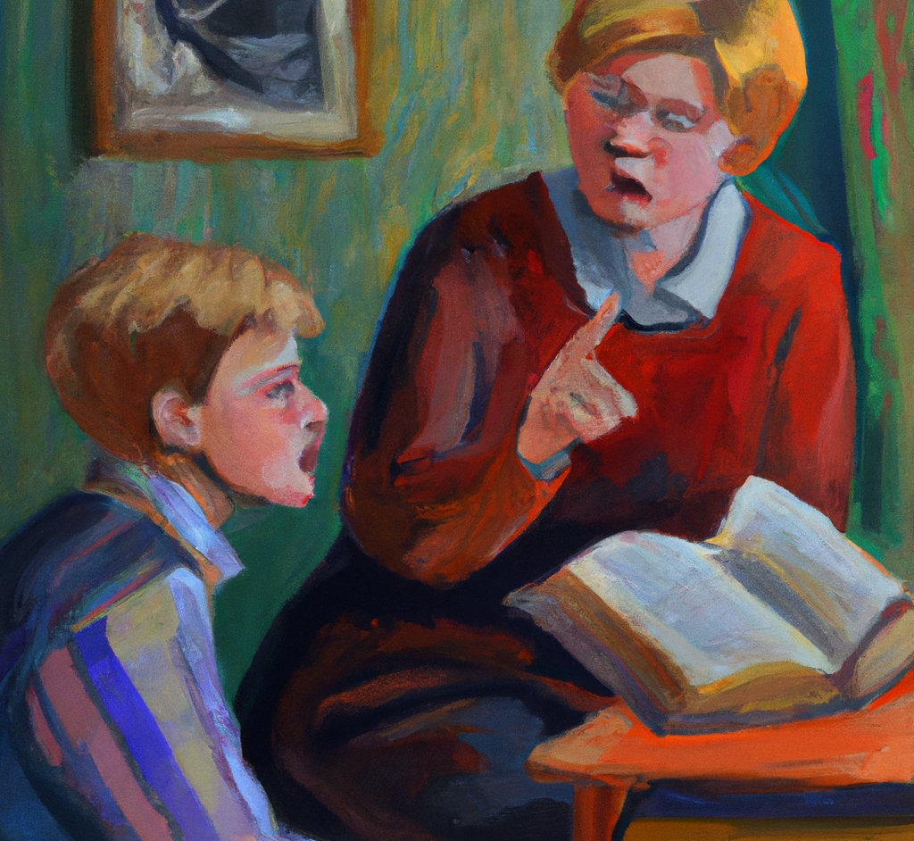
“A teacher scolds a student for noticing a flaw in the book they are reading, oil painting”
DALL·E 2

Slide 26
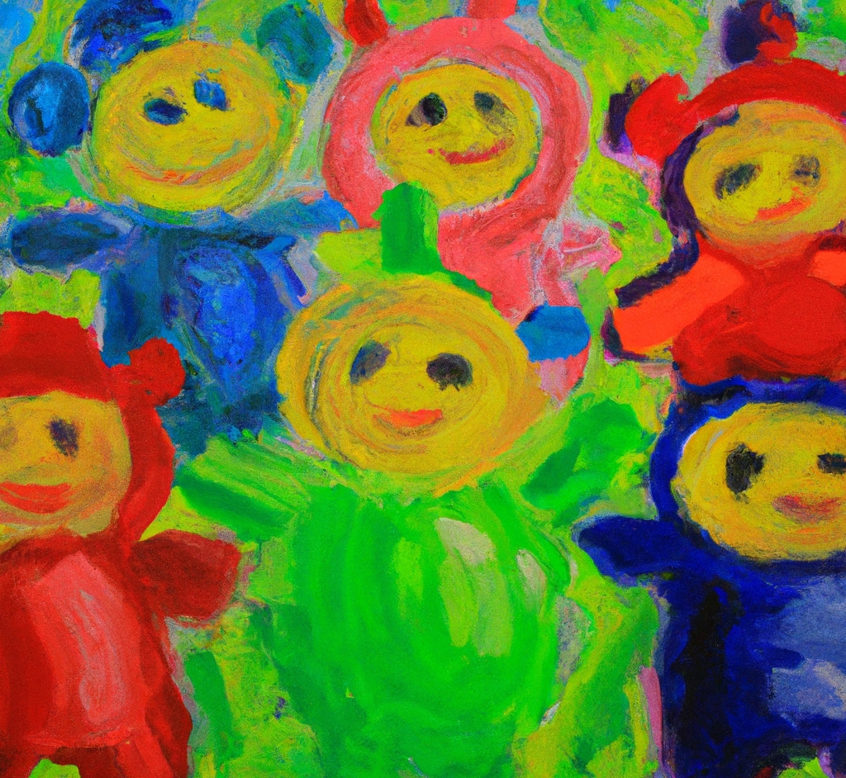
“An impressionist painting of teletubbies”
DALL·E 2

Slide 27
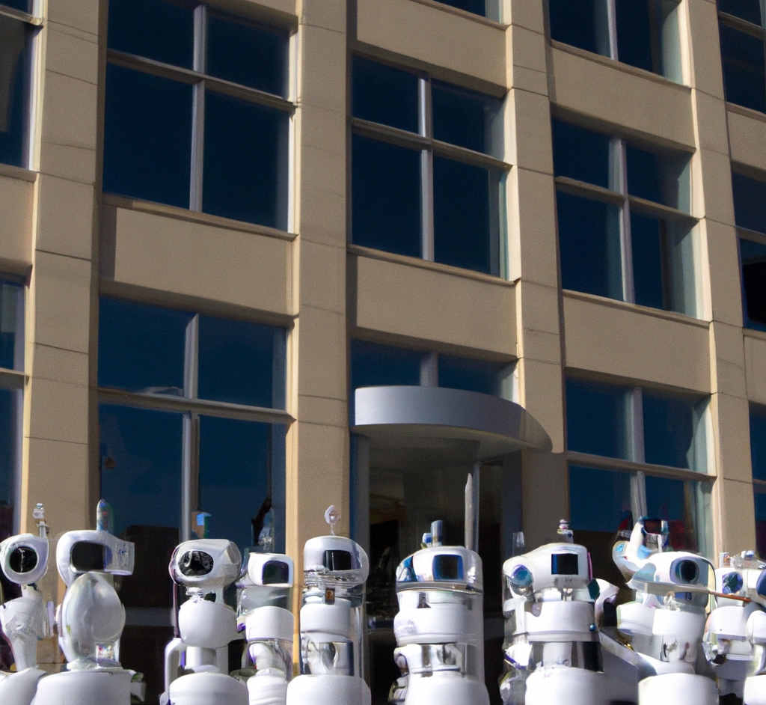
“a swarm of telepresence robots takes over an office building”
DALL·E 2

Slide 28
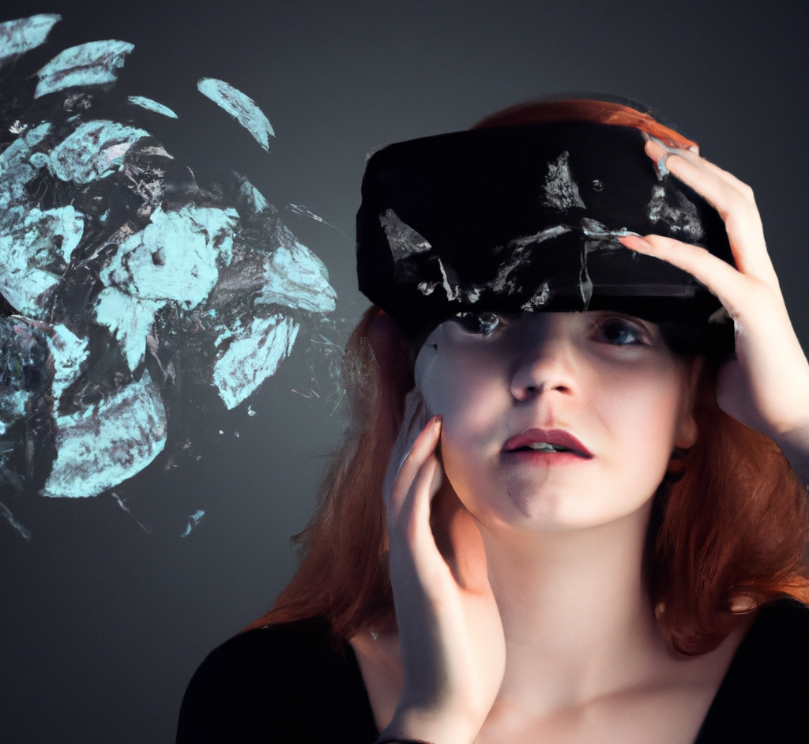
“A girl wears an augmented reality headset and imagines a layer of information covering every surface”
DALL·E 2

Slide 29

“Bee and puppycat”
DALL·E 2

Slide 30
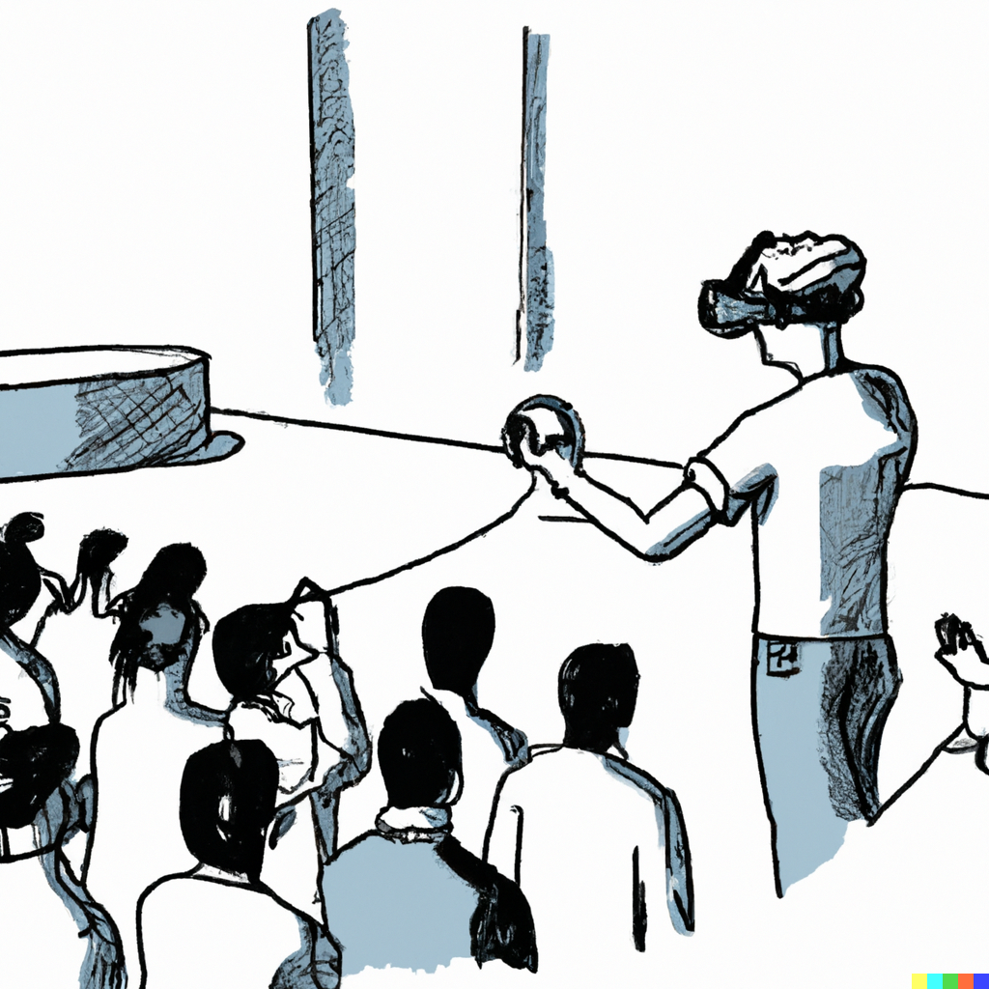
“A person practices giving a presentation in virtual reality, line art.
DALL·E 2

Slide 31
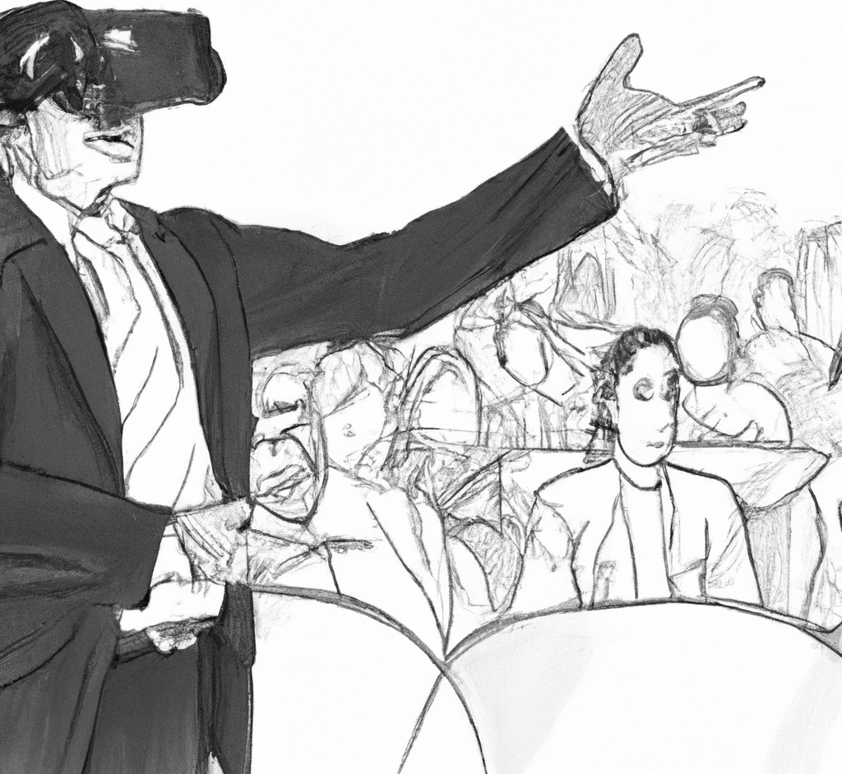
“A person practices giving a presentation in virtual reality, line art.
DALL·E 2

Slide 32
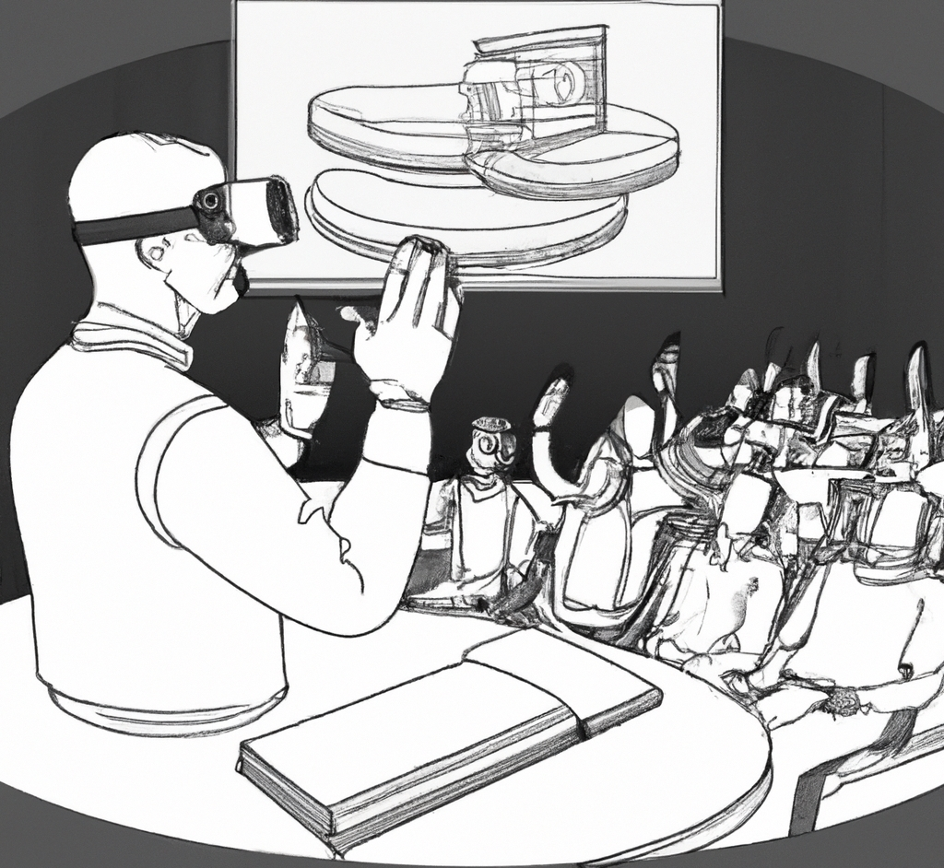
“A person practices giving a presentation in virtual reality, line art.
DALL·E 2

Slide 33
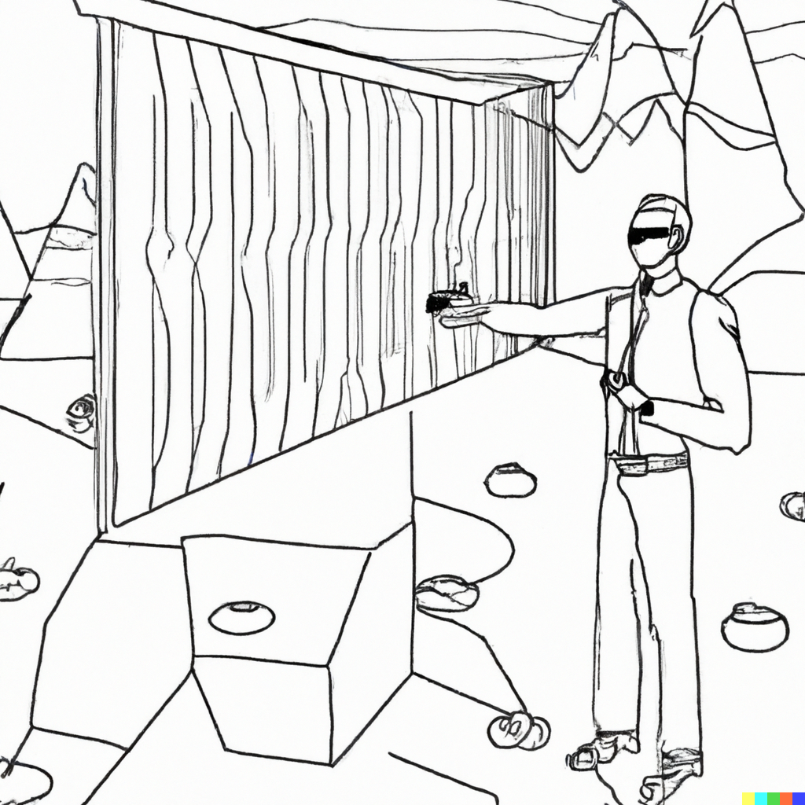
“Giving a presentation in a VR wonderland, line art”
DALL·E 2

Slide 34
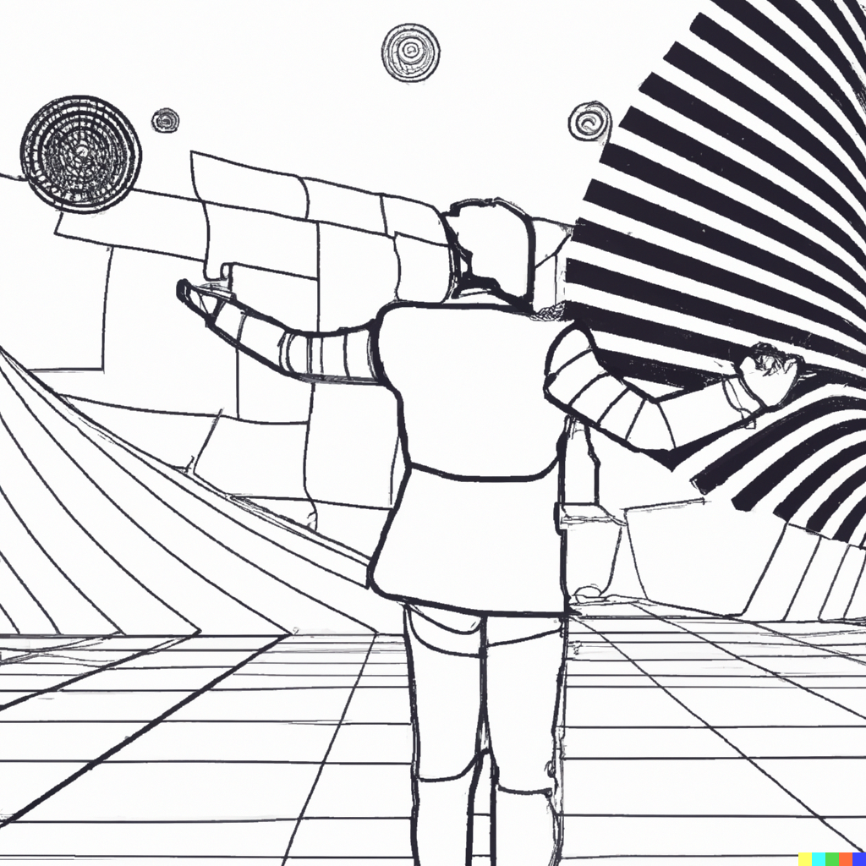
“Giving a presentation in a digital wonderland, line art”
DALL·E 2

Slide 35
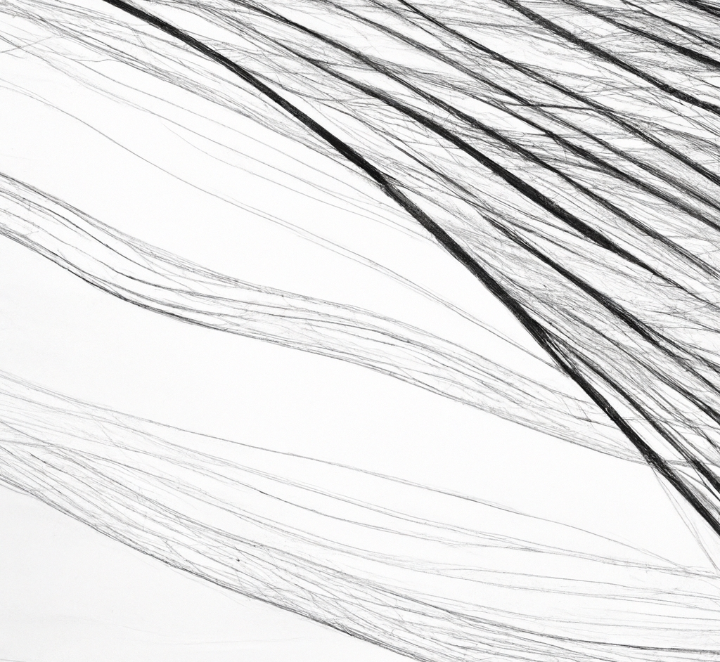
“line art”
DALL·E 2

Slide 36
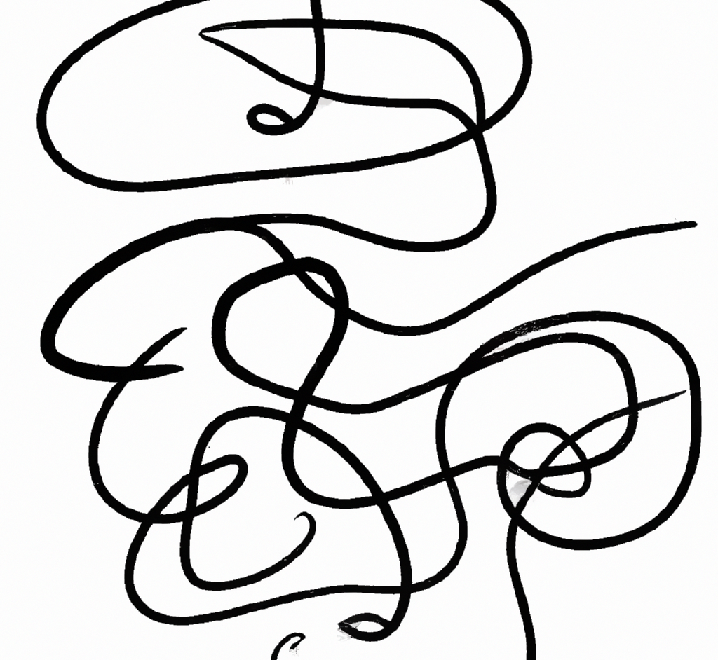
“line art”
DALL·E 2

Slide 37
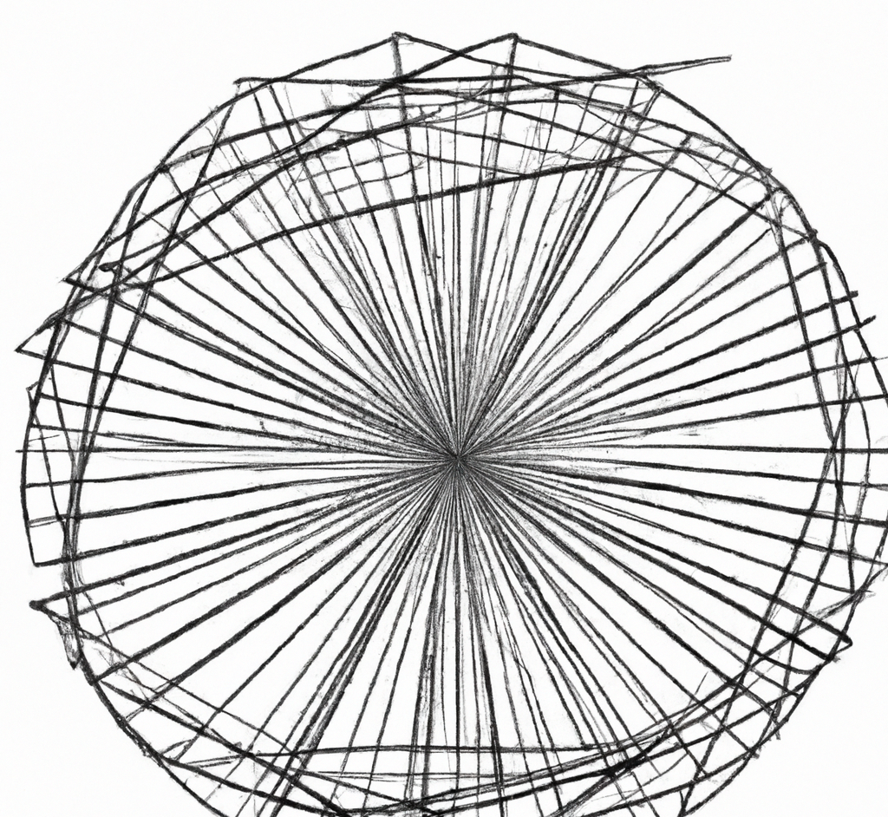
“line art”
DALL·E 2

Slide 38
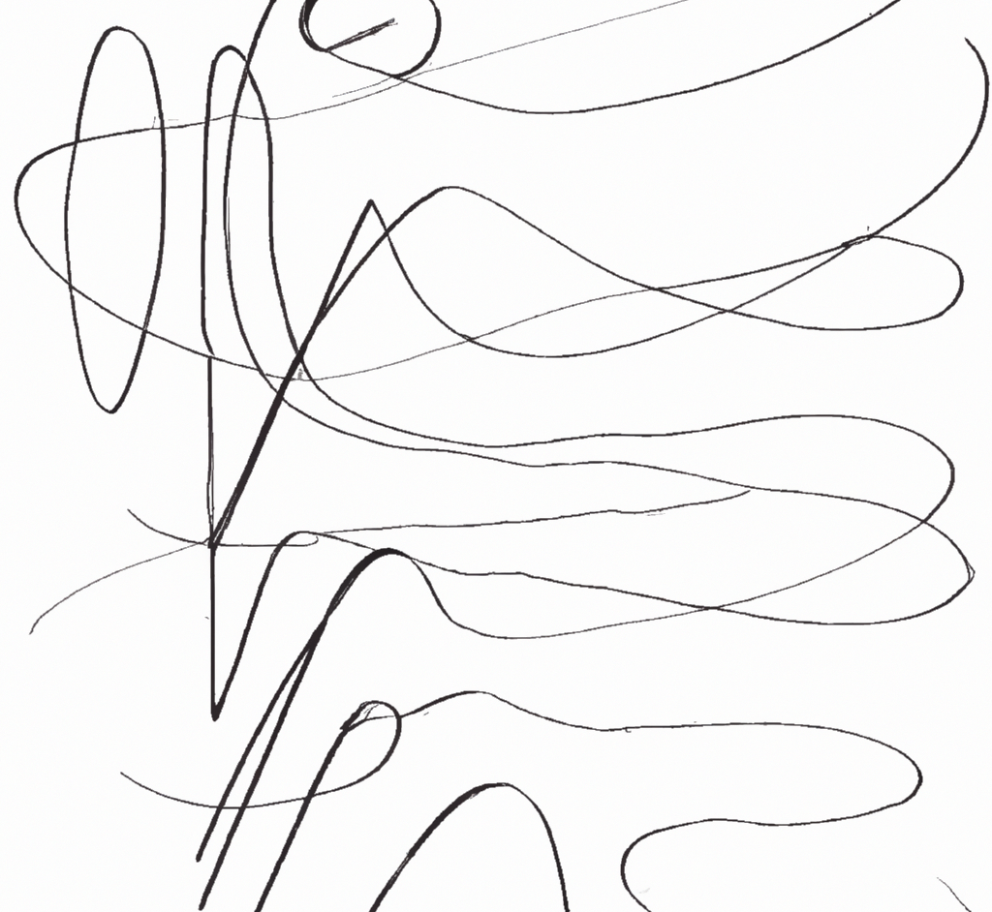
“line art”
DALL·E 2

Slide 39
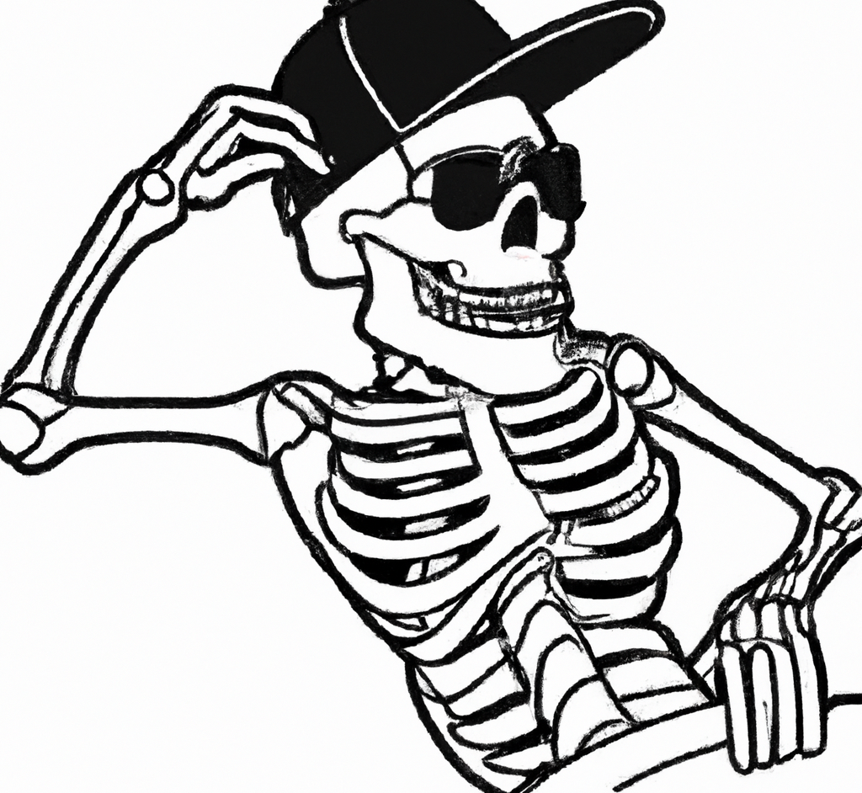
“line art of a spooky skeleton wearing a backwards baseball cap and sunglasses”
DALL·E 2

Slide 40
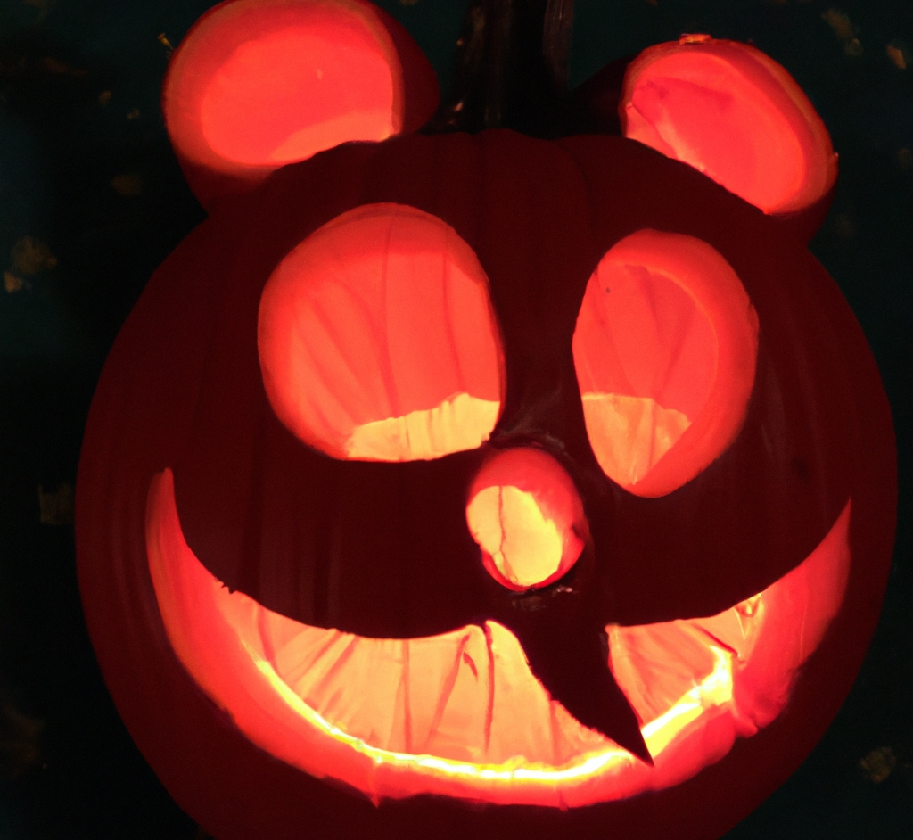
“Mickey Mouse jack-o’-lantern”
DALL·E 2

Slide 41
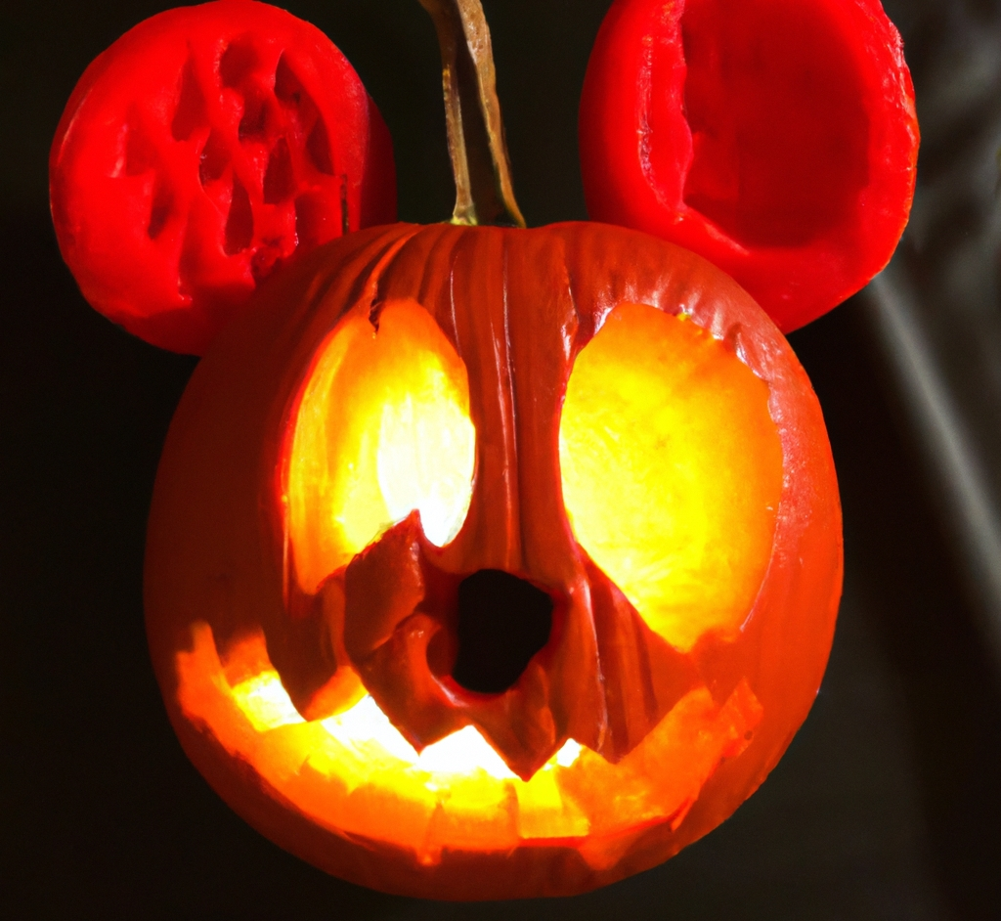
“Mickey Mouse jack-o’-lantern”
DALL·E 2

Slide 42
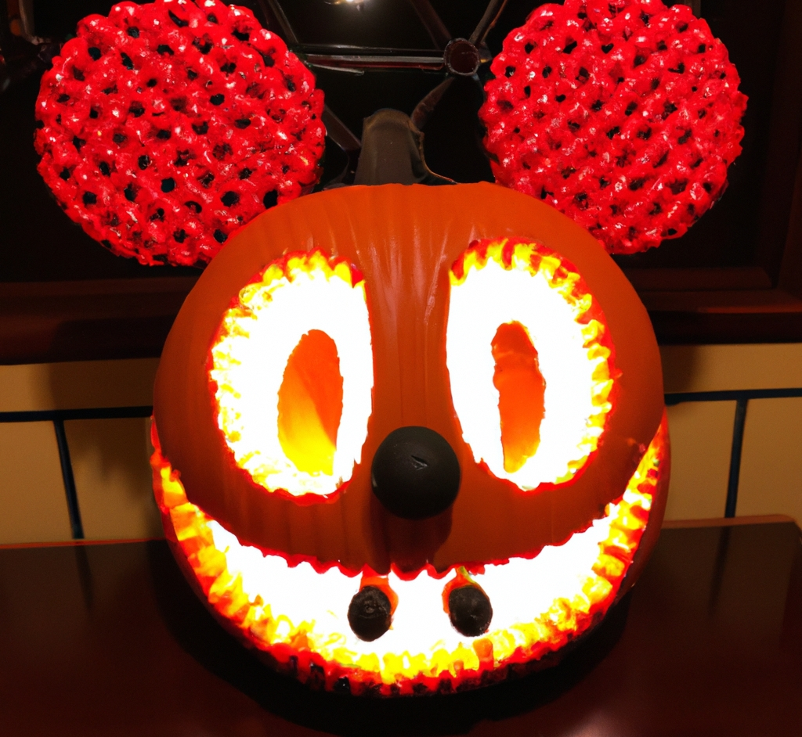
“Mickey Mouse jack-o’-lantern”
DALL·E 2

Slide 43
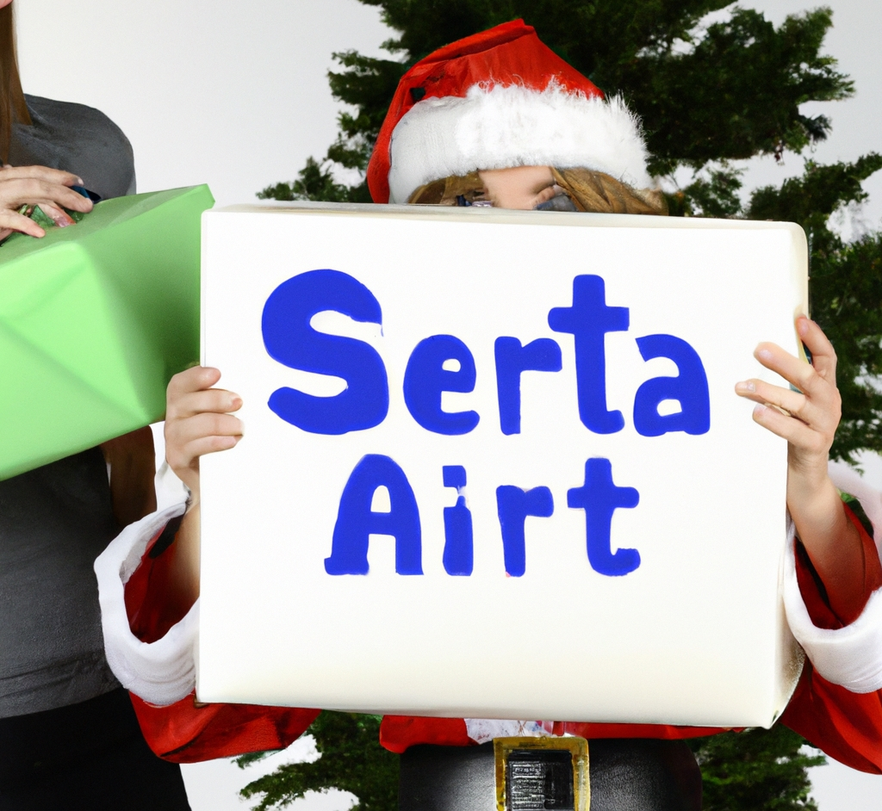
“secret santa”
DALL·E 2

Slide 44
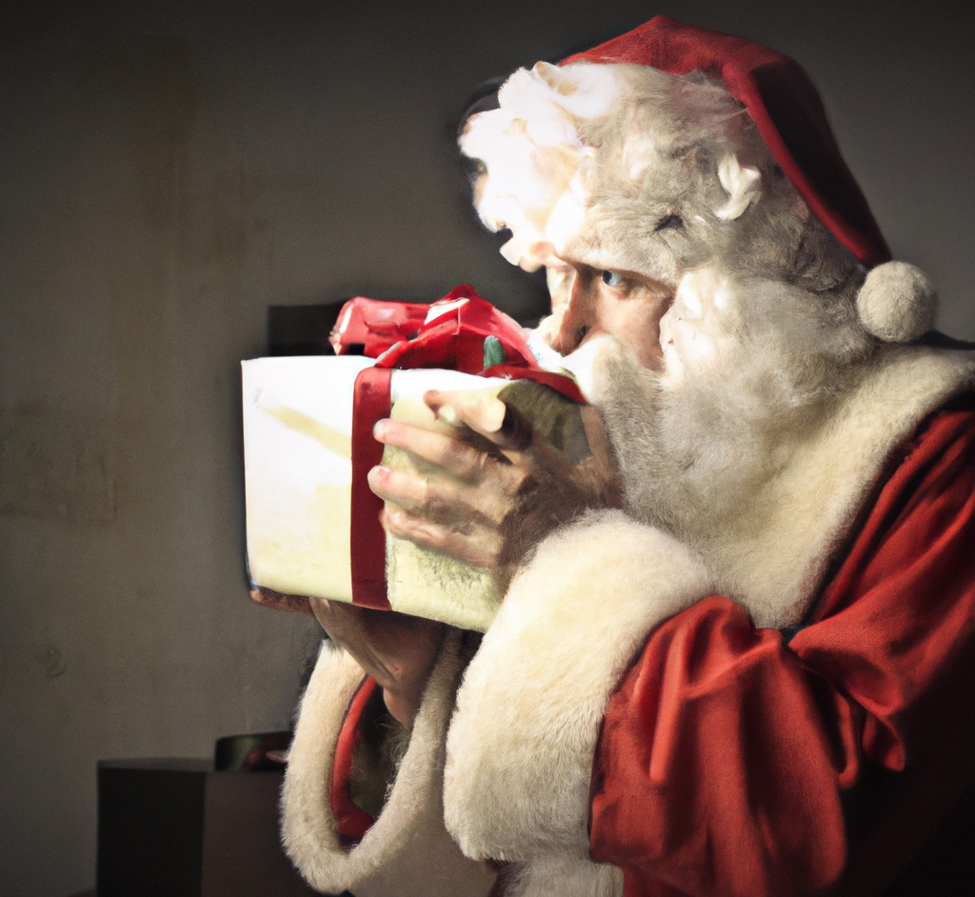
“secret santa”
DALL·E 2

Slide 45
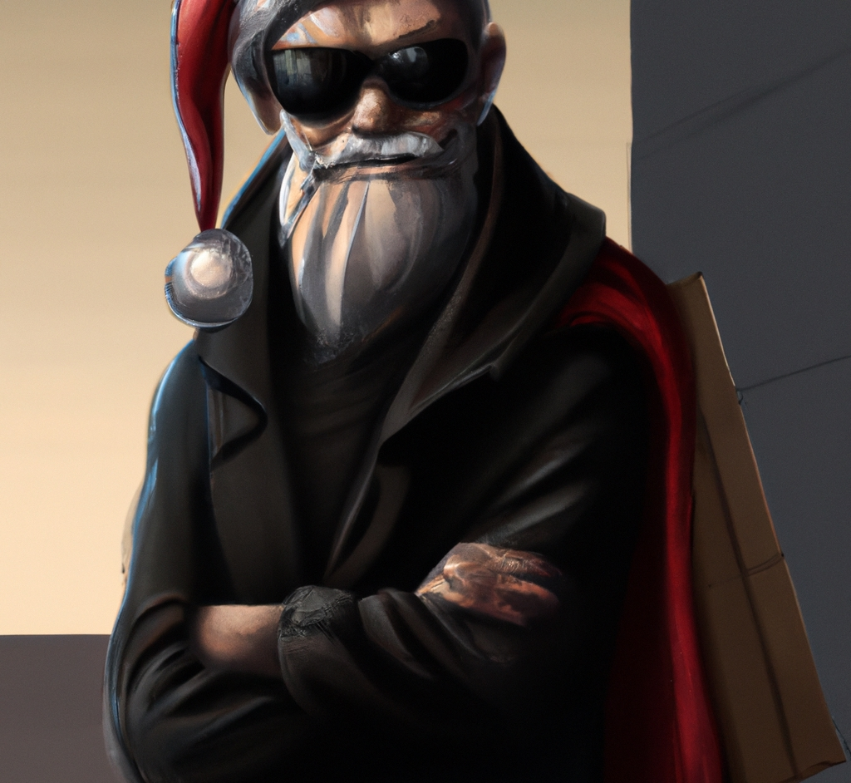
“santa claus in a black trenchcoat and sunglasses, digital art”
DALL·E 2

Slide 46
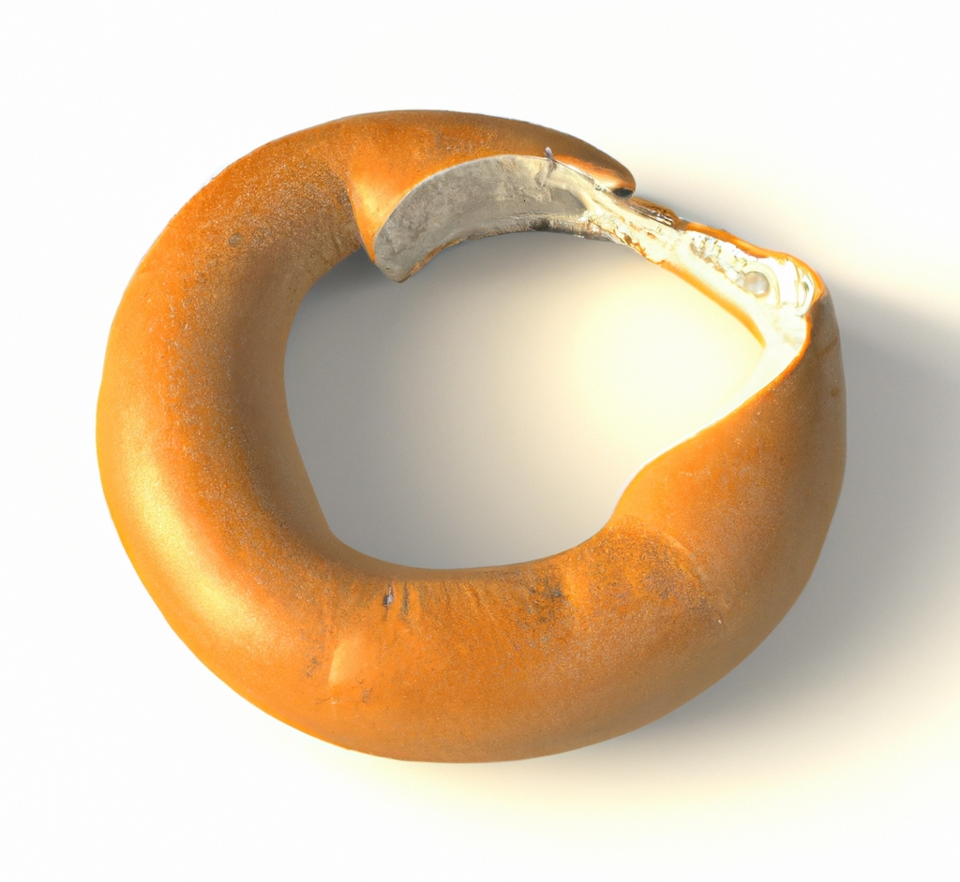
“half of a bagel, 3d render”
DALL·E 2

Slide 47
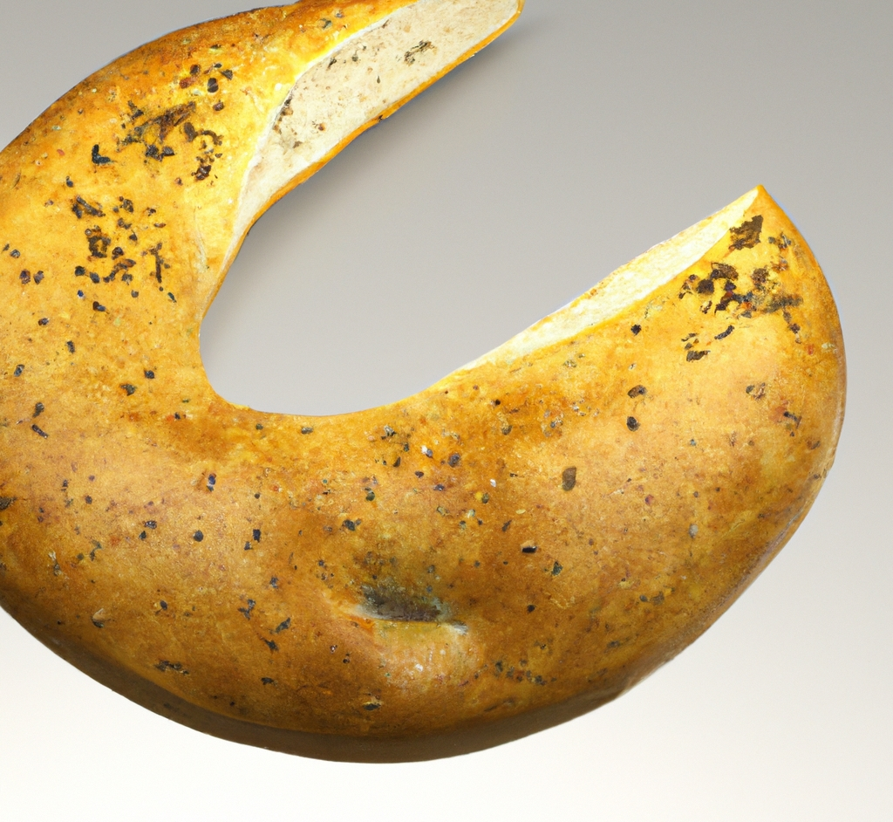
“half of a bagel, 3d render”
DALL·E 2

Slide 48
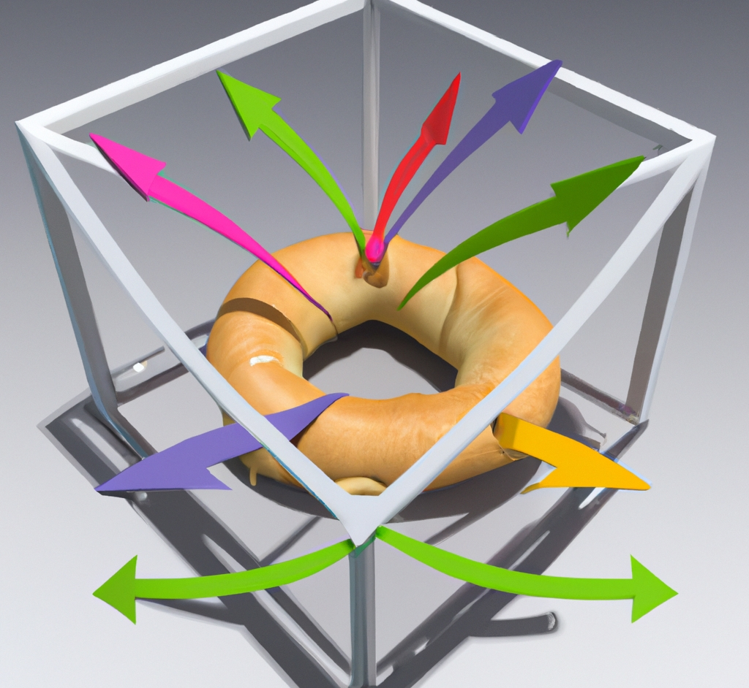
“half of a bagel surrounded by a 3d bounding box with arrows pointing in the x, y, and z axes, 3d render”
DALL·E 2

Slide 49
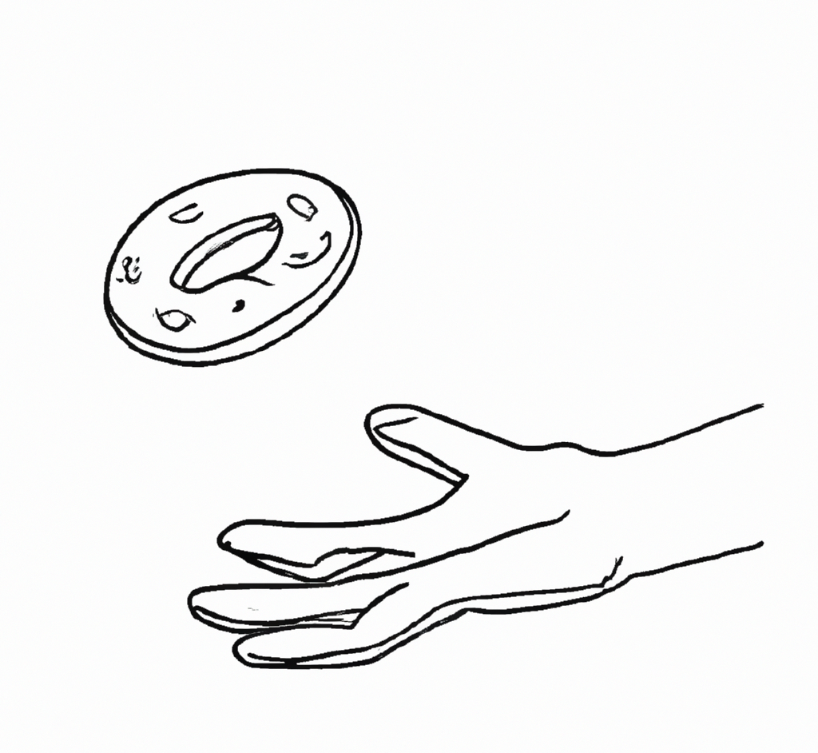
“a single bagel is levitating above an outstretched palm, line art”
DALL·E 2

Slide 50
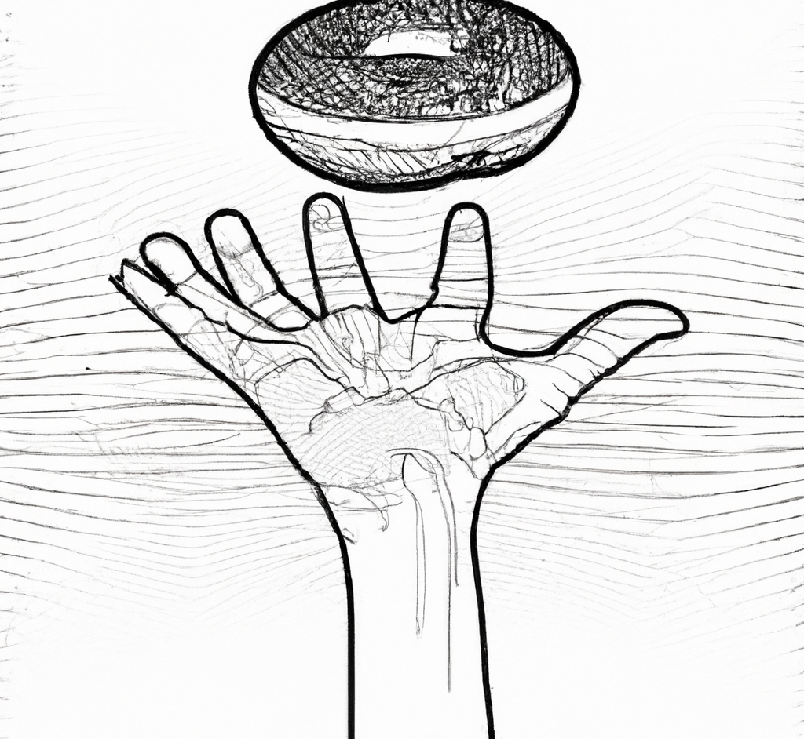
“a single bagel is levitating above an outstretched palm, line art”
DALL·E 2

Slide 51
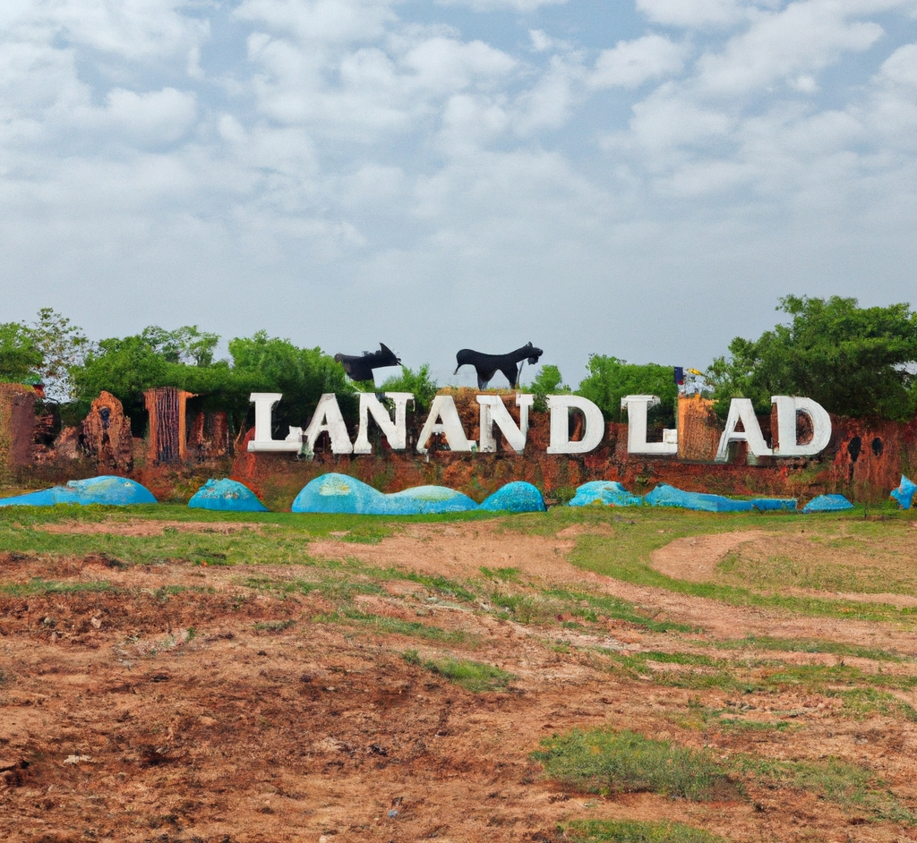
“LandLand: a theme park where all the exhibits are of land animals.”
DALL·E 2

Slide 52
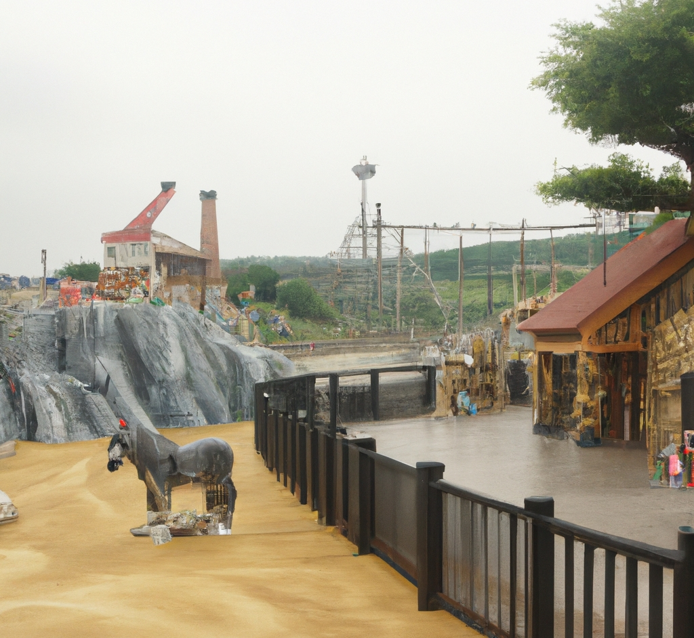
“LandLand: a theme park where all the exhibits are of land animals.”
DALL·E 2

Slide 53
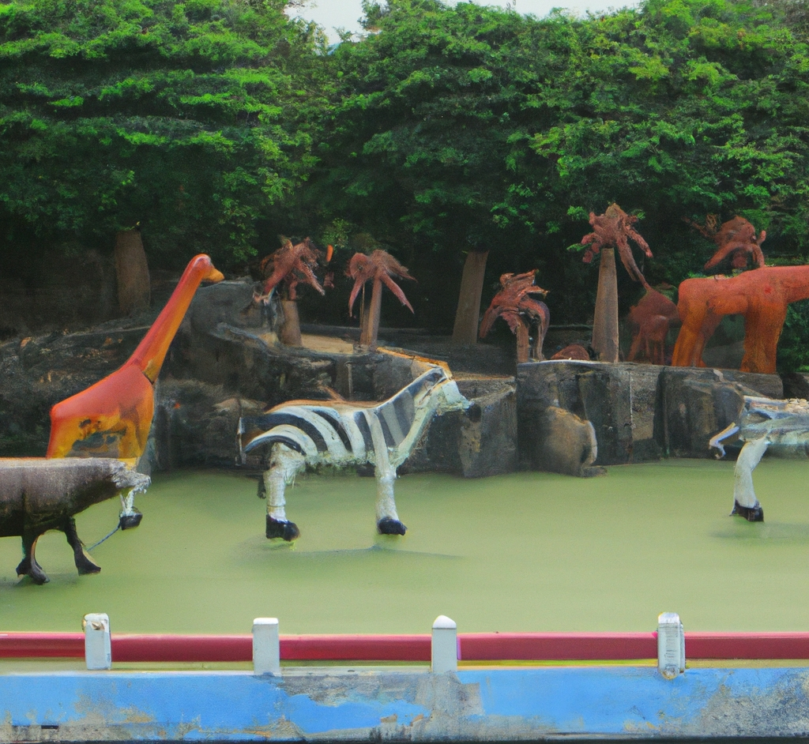
“LandLand: a theme park where all the exhibits are of land animals.”
DALL·E 2

Slide 54

“LandLand: a theme park where all the exhibits are of land animals. Gothic oil painting.”
DALL·E 2

Slide 55

“LandLand: a theme park where all the exhibits are of land animals. Gothic oil painting.”
DALL·E 2

Slide 56

“LandLand: a run down theme park where all the exhibits are of land animals. There are roller coasters and animals are dressed as clowns. The children look lost.”
DALL·E 2

Slide 57

“LandLand: a run down theme park where all the exhibits are of land animals. There are roller coasters and animals are dressed as clowns. The children look lost.”
DALL·E 2

Slide 58

“LandLand: a run down theme park where all the exhibits are of land animals. There are roller coasters and animals are dressed as clowns. The children look lost.”
DALL·E 2

Slide 59

“an ad for an iPhone from 1922, newspaper print scan”
DALL·E 2

Slide 60

“an ad for an iPhone from 1922, newspaper print scan”
DALL·E 2

Slide 61

“machine learning, psychedelic synthwave art”
DALL·E 2

Slide 62

“corgi wearing a beret, synthwave”
DALL·E 2

Slide 63

“cat, synthwave aesthetic”
DALL·E 2

